Slide 1
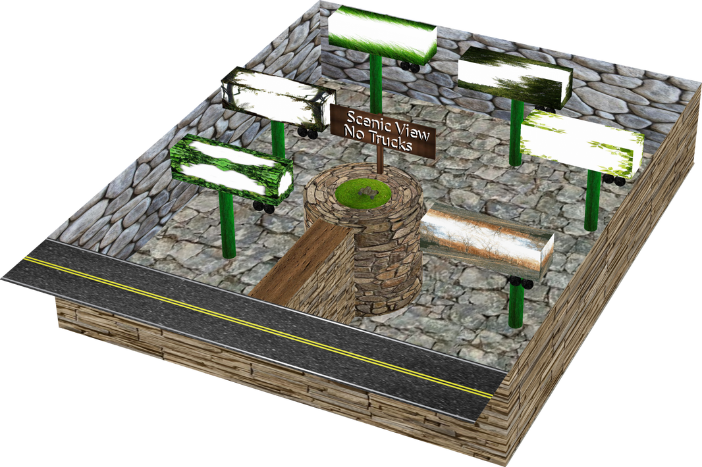
End Times & Pre-Times: Part 5
Humor

Slide 2
End Times & Pre-Times: For the rest of our days – Part 1
The monuments of ancient times
A copy of home
Where once we knew all
And the universe we did roam
There at the beginning
When creation was made
Were the ones that had shouted
later then became afraid
Caught in our own web
And longing for more
We left that habitation
For those we adored
Trading with knowledge
A deception was made
Always closer to dominance
And closer to pain
Wickedness within us
Our hearts did decline
To carry out the mission
Of protecting mankind
Usurping authority
With something you could see
It was good to the eyes
Nearby on a tree
Revelation 21:16 ICB The city was built in a square. Its length was equal to its width. The angel measured the city with the rod. The city was 1,500 miles long, 1,500 miles wide, and 1,500 miles high.
Job 38:7 KJV When the morning stars sang together and all the sons of God shouted for joy?
Genesis 6:2 That the sons of God saw the daughters of men that they were fair; and they took them wives of which they chose.
1 Enoch 8:1-3 "And Azazel taught men to make swords, and knives, and shields, and breastplates, and made known to them the metals of the earth and the art of working them, and bracelets, and ornaments, and the use of antimony, and the beautifying of the eyelids, and all kinds of costly stones, and all coloring tinctures. And there arose much godlessness, and they committed fornication, and they were led astray, and became corrupt in all their ways. Semjaza taught enchantments, and root-cuttings, Armaros the resolving of enchantments, Baraqijal astrology, Kokabel the constellations, Ezeqeel the knowledge of the clouds, Araqiel the signs of the earth, Shamsiel the signs of the sun, and Sariel the course of the moon. And as men perished, they cried, and their cry went up to heaven."
1 Enoch 7:1-2
"And all the others together with them took unto themselves wives, and each chose for himself one, and they began to go in unto them and to defile themselves with them, and they taught them charms and enchantments, and the cutting of roots, and made them acquainted with plants. And they became pregnant, and they bare great giants."
Genesis 3:1 Now the serpent was more subtle than any beast of the field which the Lord God had made. And he said unto the woman, Yea, hath God said, Ye shall not eat of every tree of the garden?

Slide 3
End Times & Pre-Times: For the rest of our days – Part 2
Then came the plan
To corrupt in the mind
No more to be perfect
now a mixed kind
The ultimate battle
We thought we had won
Finally getting rid of
God’s only son
But on the 3rd day
He rose from the grave
and did herald the decree
from which there’s no escape
Still we trudge on
With one final goal
To deceive and infect
All the ones who now know
Our fate is sealed
But we rant and we rave
to deceive mankind
for the rest of our days
Genesis 6:4 There were giants in the earth in those days; and also after that, when the sons of God came in unto the daughters of men, and they bare children to them, the same became might men which were of old, menu of renown.
John 10:10 KJV
The thief comes not but for to kill, steal, and to destroy...
Mark 16:6 KJV
And he saith unto them, be not affrighted: Ye seek Jesus of Nazareth, which was crucified: he is risen; he is not here: behold the place where they laid him.
John 10:10 KJV
The thief comes not but for to kill, steal, and to destroy...
Peter 3:19-20 By which also he went and preached unto the spirits in prison; Which sometime were disobedient, when once the longsuffering of God waited in the days of Noah, while the ark was a preparing, wherein few, that is eight souls were saved by water.

Slide 4
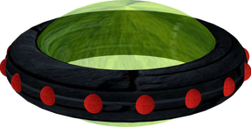
End Times & Pre-Times: Who’s out there?
Ants who want delicious treats
One of the things that people don't realize is what the existence of a UFO means. If even one sighting is real, that means that somewhere (whether that be in the cosmos or another dimension) there is some kind of manufacturing plant - whatever shape that may take. A while back a concept was laid out saying that its not impossible for an ant in the amazon rain forest to arrive in downtown Seattle so he could take the fairy out to one of the islands - but, its highly improbable. First of all you have the intelligence of the ant to consider - an ant doesn't know that there is an island that a ferry traverses to over the water, let alone be on another continent altogether. So if an ant crawled onto a jungle explorer and sat on their shoe all the way back to town, then to the airport, and thus arrive in Seattle at Seatac airport. From here, the ant would have to hitch a ride from the airport down to a the docks to board a fairy and finally be on this way to those delicious island treats that he didn't know he wanted. In order for this to happen, it would almost assuredly be by sheer accident and even if one ant managed to accomplish this, the likely hood of 2, 3, 10 becomes progressively less and less likely if it wasn't so nearly impossible already.

Slide 5
End Times & Pre-Times: Understanding Dimensions
One way for us as humans to understand things that are more complicated than we are used to is to look one level below. For example, to try to understand 4 dimensions the best way to look at it is to go to 2D dimensions. In a 2D world your environment is a rectangle for an easy analogy. You can be a line, a triangle, a square, a pentagon, an irregular polygon, a hexagon, an octagon and all the way up to a circle with infinite points having your only limitation be the planck length. So if a 3 dimensional sphere passing through a 2 dimensional plane starts as a small circle progressively getting larger until it hits the half way point and then starts getting smaller and disappears. An ellipsoid would follow the same pattern except it would be more oval shaped. A cone however, would start small and progressively get bigger until it disappears suddenly or in reverse if it passed through in the other direction. Go one step farther and take any random 3D object and start it spinning on multiple vectors as it passes through. The 2D observers would really get a wild show seeing bizarre shapes that might almost appear like a flashing depending on the rotational vector speeds. At this point we still don't understand 4D, but we at least start to understand how a higher dimensional object than 3D would look to us. It would be equally as weird for us to see it if not more and we have a whole extra dimension than the 2D observers.

Slide 6
End Times & Pre-Times: Limited Knowledge, Clues & the Short List
Limited knowledge
I said all that to say this: keep in mind that we know so little about the nature of the universe and quantum physics that we may not even have a reference point and to some extent might be equivalent to the ant, even though we are a more intelligent species - but lets look for clues.
Clues
In Ecclesiastes 1:9 its says, "The thing that hath been, it is that which shall be; and that which is done is that which shall be done: and there is no new thing under the sun." This was written by Solomon, who was the wisest person who ever lived with the exception of Jesus which goes without saying but is worth saying all the same. In all fairness we would have to ask is that only referring to our sun or does that include other suns as well. However, for the clue search, we still "stick" somewhat with our sun and venture beyond when necessary.
The Short list
Trinity - Father, Son & Holy Spirit - (Always have existed, a concept that we have a tough time understanding)
Angels, Fallen Angles & Demons - (Created beings but immortal - in part 2 this category will be broken down for better understanding)
Gray Aliens - (Perhaps some type of clone or empty shell that something may be able to inhabit)
Animal Human Angle Hybrids - (Had unusual abilities, but most perished in Noah's flood)
Modern Day Human Animals Hybrid - (Example: Like growing an ear on a mouse and other combinations)
Hybrid animals - (these don't really qualify as a who...but, Ligers, Tigons, Goats with spider silk in their milk...)
Reptilians? - Unknown
4 faced creatures - in heaven – man, lion, ox, eagle: Revelation 4:8 – beasts full of eyes / wings

Slide 7
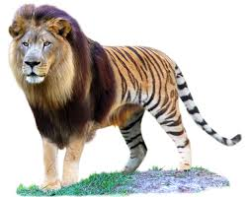
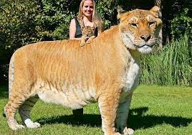
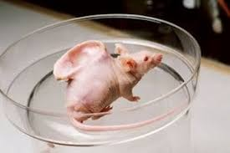
End Times & Pre-Times: Hybrids
Tigon
Liger
Genesis 1:21 - And God created great whales, and every living creature that moveth, which the waters brought forth abundantly, after their kind, and every winged fowl after his kind: and God saw that it was good.
Goat with Spider Silk
Mouse with Human Ear

