Slide 1
Discussion Questions
Question: About how many years has Jesus been sitting on the left hand of the Father?
Question: What color are the streets in heaven? What are they made of?
Question: Who’s name is above every name even in the world to come?
Question: Where is the tabernacle of God?
Question: What is in Jesus’ Father’s house? How many are there?
Question: How many gates are there in the New Jerusalem? What are the gates made out of?
Question: Who is the only one that the Father has begotten? What are 3 scriptures that prove that?
Question: How do we know that Jesus is looking out for us?
Question: What is the result of the eyes of our understanding being enlightened?
Question: How high is Jesus set above all principalities and powers? Who put him there?
Question: Can angels take on the form of man?
Question: What is significant about mansions?
Question: What manner will Jesus come in when he returns?
Question: Who is the head of the church?
Question: Why were the men of Galilee gazing up into heaven?
Question: Where is the template located in the New Jerusalem?
Question: How long has our place in heaven been under construction?
Question: How do we know there is no danger in the new Jerusalem?

Slide 2
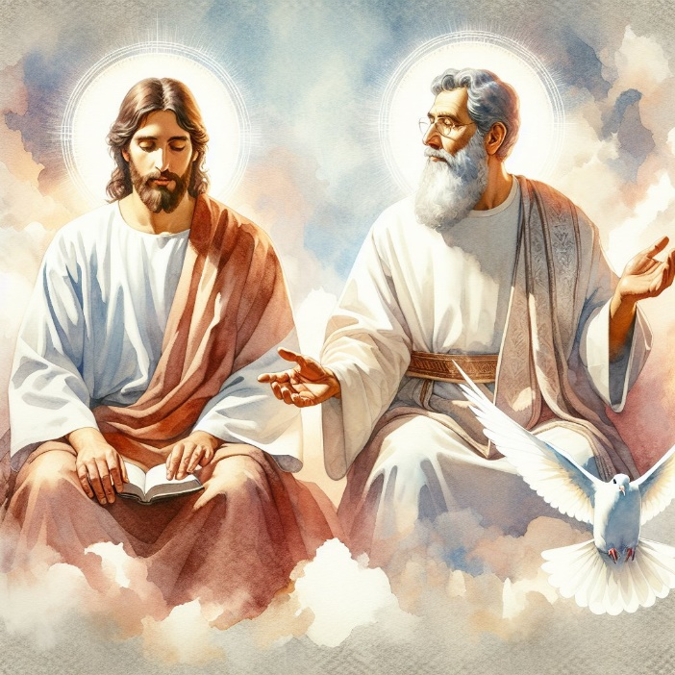
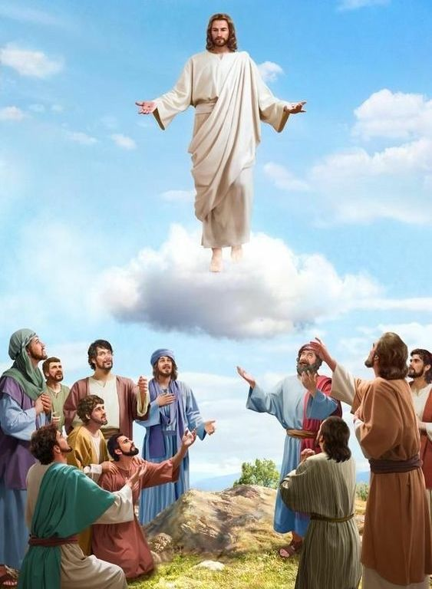
Heaven Part 2
Jesus Ascends into Heaven
God doesn’t wear glasses – and Jesus is not solemn
Mark 16:19
19 So then after the Lord had spoken unto them, he was received up into heaven, and sat on the right hand of God.
Hebrews 1:5
5 For unto which of the angels said he at any time, Thou art my Son, this day have I begotten thee? And again, I will be to him a Father, and he shall be to me a Son?
Acts 1:10-11
10 And while they looked stedfastly toward heaven as he went up, behold, two men stood by them in white apparel;
11 Which also said, Ye men of Galilee, why stand ye gazing up into heaven? this same Jesus, which is taken up from you into heaven, shall so come in like manner as ye have seen him go into heaven.
Ephesians 1:17-22
17 That the God of our Lord Jesus Christ, the Father of glory, may give unto you the spirit of wisdom and revelation in the knowledge of him:
18 The eyes of your understanding being enlightened; that ye may know what is the hope of his calling, and what the riches of the glory of his inheritance in the saints,
19 And what is the exceeding greatness of his power to us-ward who believe, according to the working of his mighty power,
20 Which he wrought in Christ, when he raised him from the dead, and set him at his own right hand in the heavenly places,
21 Far above all principality, and power, and might, and dominion, and every name that is named, not only in this world, but also in that which is to come:
22 And hath put all things under his feet, and gave him to be the head over all things to the church,

Slide 3
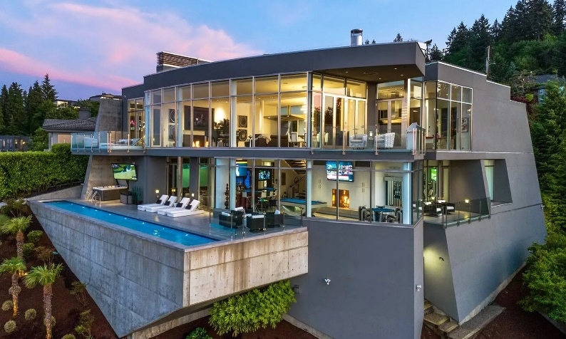
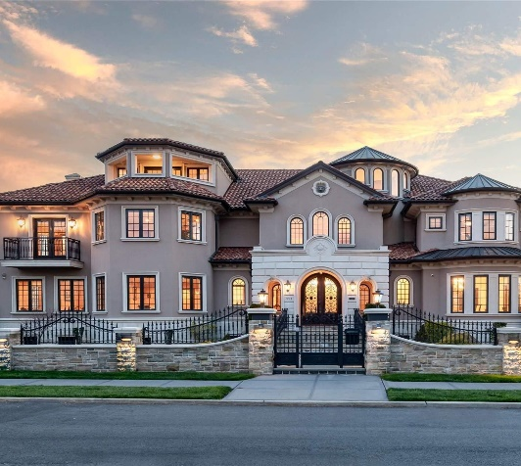
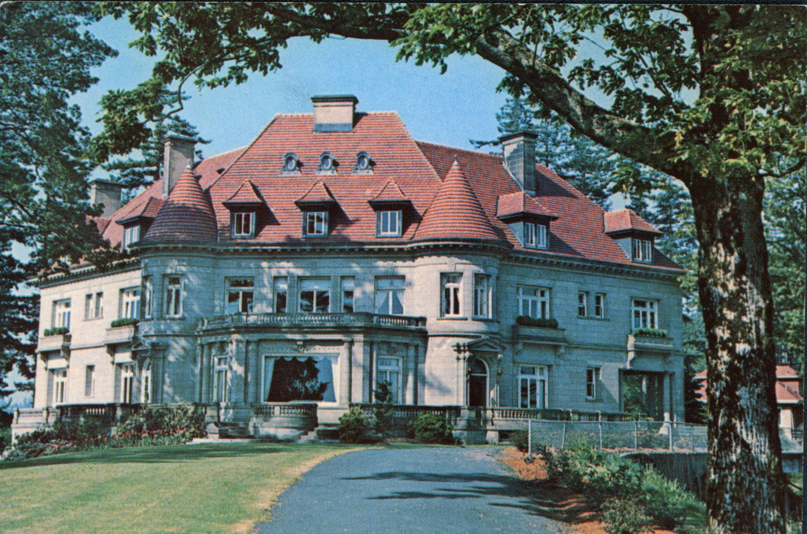
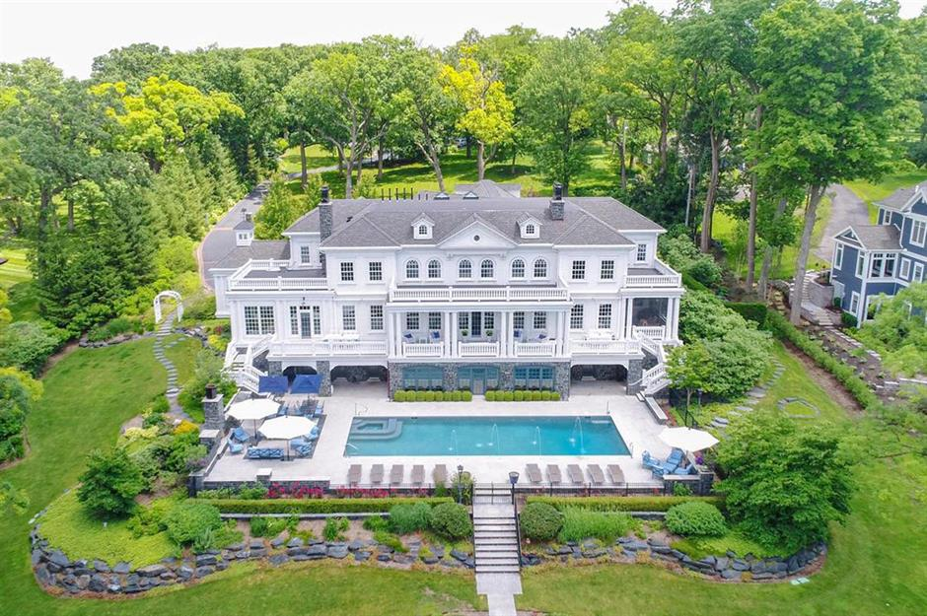
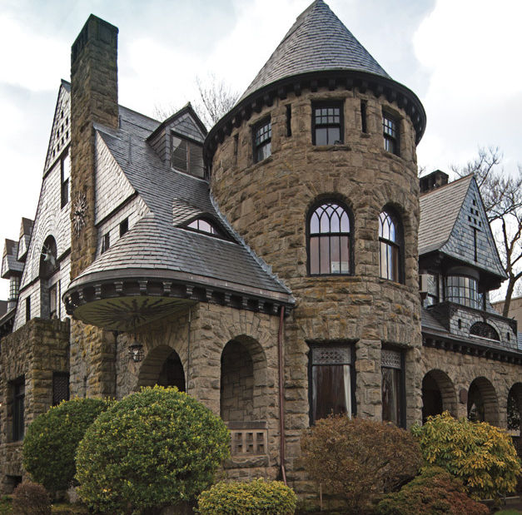
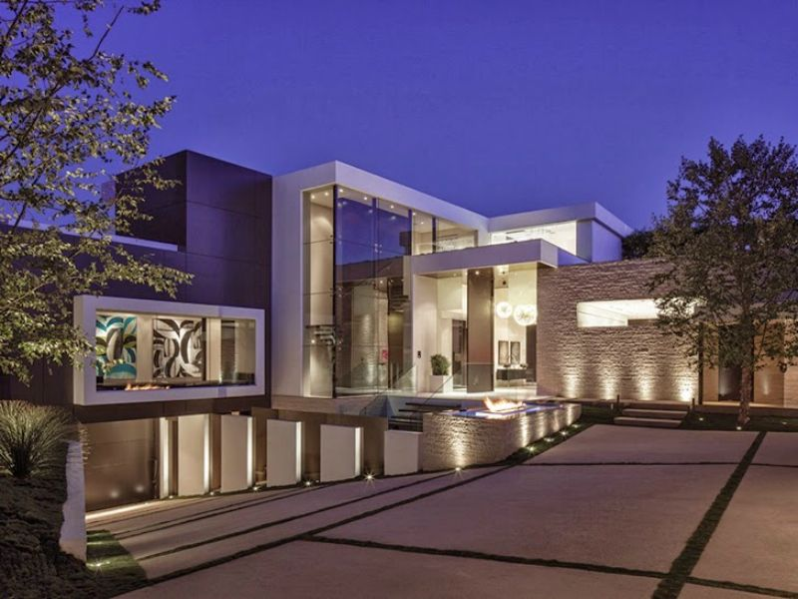
What is Heaven like? It’s a nice place!
2000 years
Jesus made a point to mention this – it must be important – he’s looking out for us – he would have told us if it were not so
John 14:2
² In my Father's house are many mansions: if it were not so, I would have told you. I go to prepare a place for you.
John 14:3
3 And if I go and prepare a place for you, I will come again, and receive you unto myself; that where I am, there ye may be also.

Slide 4
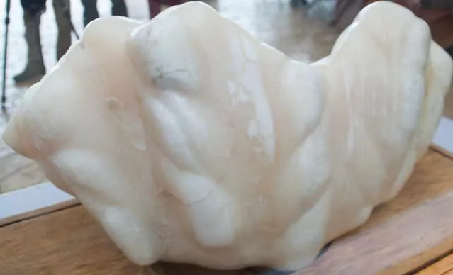
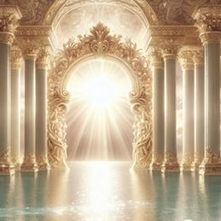
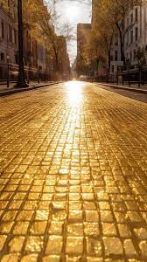
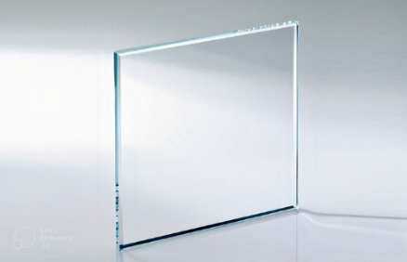
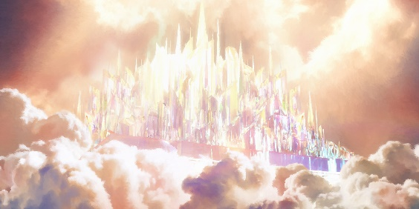
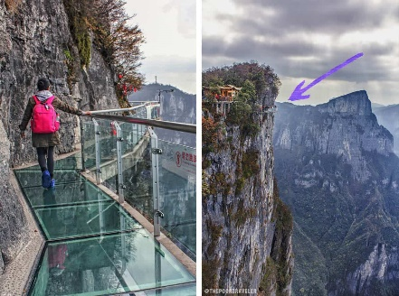
What is the New Jerusalem like?
Revelation 21:2-3
2 And I John saw the holy city, new Jerusalem, coming down from God out of heaven, prepared as a bride adorned for her husband.
3 And I heard a great voice out of heaven saying, Behold, the tabernacle of God is with men, and he will dwell with them, and they shall be his people, and God himself shall be with them, and be their God.
Revelation 21:21
21 And the twelve gates were twelve pearls: every several gate was of one pearl: and the street of the city was pure gold, as it were transparent glass.
Revelation 21:22
22 And I saw no temple therein: for the Lord God Almighty and the Lamb are the temple of it.
Revelation 21:25
25 And the gates of it shall not be shut at all by day: for there shall be no night there.

Slide 5
Discussion Questions
Question: About how many years has Jesus been sitting on the left hand of the Father?
Question: What color are the streets in heaven? What are they made of?
Question: Who’s name is above every name even in the world to come?
Question: Where is the tabernacle of God?
Question: What is in Jesus’ Father’s house? How many are there?
Question: How many gates are there in the New Jerusalem? What are the gates made out of?
Question: Who is the only one that the Father has begotten? What are 3 scriptures that prove that?
Question: How do we know that Jesus is looking out for us?
Question: What is the result of the eyes of our understanding being enlightened?
Question: How high is Jesus set above all principalities and powers? Who put him there?
Question: Can angels take on the form of man?
Question: What is significant about mansions?
Question: What manner will Jesus come in when he returns?
Question: Who is the head of the church?
Question: Why were the men of Galilee gazing up into heaven?
Question: Where is the template located in the New Jerusalem?
Question: How long has our place in heaven been under construction?
Question: How do we know there is no danger in the new Jerusalem?

