Slide 1
Prayer – Part – 1 - Humor

Slide 2
Prayer – Part 1 – Discussion Questions
Why should we be bold when we pray?
What do we obtain when we come boldly to the throne of Grace?
How would you describe a kings decree?
What happens when we decree a thing (good or bad)?
Should we pray long prayers? (why or why not)?
Are we kings?
When does the Father know what we have need of?
What does the “Therefore” in Mark 11:24 refer to?
How do you get God’s word to abide in you?
How is the Father glorified?
How long should you confess scripture before you pray?
How do you talk yourself out of a victory?
What was Abraham fully persuaded of?
What was Abram fully persuaded of?
Name one scripture that you can apply to receive your healing?
What two visual elements helped Abraham apply his faith for God’s promise?
What happens when you write the vision and make it plain upon tables?
Why should you take time to develop your faith before you pray?
What should you do if you think evil thoughts?
What is an evil thought?
What scripture can you use to speak increase over you and your children?
https://www.mathcompiler3d.com/bible-study

Slide 3
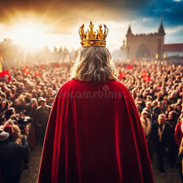
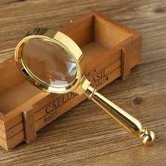
Prayer – Part 1 – Being Bold and long prayers
God says come boldly unto the throne of grace and obtain mercy and find grace to help in a time of need – prayer is respectful – but it is always bold.
Hebrews 4:16
¹⁶ Let us therefore come boldly unto the throne of grace, that we may obtain mercy, and find grace to help in time of need.
Matthew 6:7-8
7 But when ye pray, use not vain repetitions, as the heathen do: for they think that they shall be heard for their much speaking.
8 Be not ye therefore like unto them: for your Father knoweth what things ye have need of, before ye ask him.
When a king makes decree’s and he is very bold!
Are we Kings?
Revelation 1:6
⁶ And hath made us kings and priests unto God and his Father; …
Proverbs 25:2
² It is the glory of God to conceal a thing: but the honour of kings is to search out a matter.
Job 22:28
²⁸ Thou shalt also decree a thing, and it shall be established unto thee: and the light shall shine upon thy ways.

Slide 4
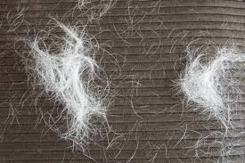
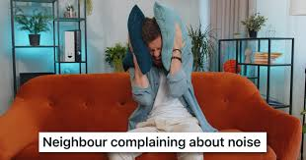
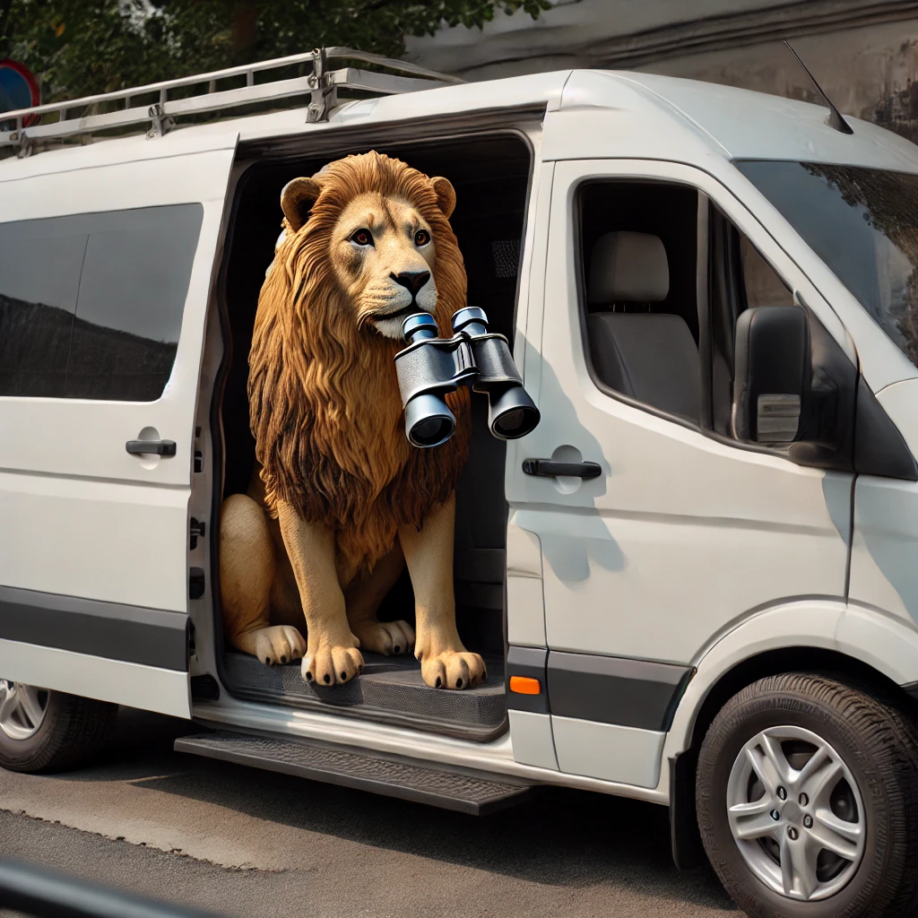
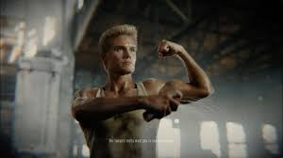
Roaring Lion Animal Control Services
Are your neighbors complain about the roaring coming from your home at all hours of the day?
Does your adversary park across the street in an unmarked van and watch you with binoculars?
Do you wake up in the morning to find lion hair all over your couch?
You too can be sober and vigilant
For just 1 mustard seed of Faith
you can purchase Submit yourself to God deodorant
Resist the devil and with one sniff, he will flee.
We now return to your regularly scheduled Bible study

Slide 5
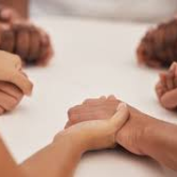
Prayer – Part 1 – Words, the foundation of prayer
Most times when talking about faith we jump directly to Mark 11:23 – and rightly so –but we should read mark 11:24 first. When we do we find a phrase that says – “Therefore I say unto you”
Whenever there is a “therefore” – stop and see what its therefore
When we run across the word therefore, we realize, that what follows the word therefore, is directly related to what came before the “Therefore”
John 15:7
7 If ye abide in me, and my words abide in you, ye shall ask what ye will, and it shall be done unto you.
So lets go back to Mark 11:24 – look again at word “Therefore” again – the basis of prayer is the words that you say, and believe and doubt not in your heart – those are the words that come to pass. In John 16:7 If ye abide in me, and my words abide in you, ye shall ask what ye will, and it shall be done unto you.
8 Herein is my Father glorified, that ye bear much fruit; so shall ye be my disciples.
Mark 11:24
Therefore I say unto you, What things soever ye desire, when ye pray, believe that ye receive them, and ye shall have them.
Don’t focus on the mountain – focus on the principle in the scripture
Rephrased: Truly I say unto you, if you believe what you say will come to pass, you will have whatsoever you say

Slide 6
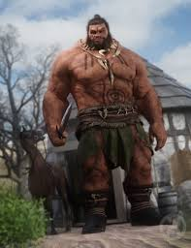
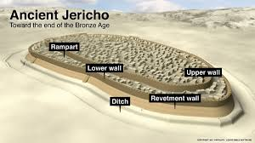
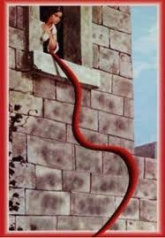
Retaining Wall Removal Services
Are you finding that there is a red cord hanging from one of the windows on those walls?
Are the mighty men of valor just shaking their heads at you like you don’t amount to much?
Do you have circular retaining walls that you just can’t get rid of?
Have I got the deal for you!
For just 1 mustard seed of Faith
You can purchase 7 priests with ram’s horns included, a map of the city, and one class in public speaking to grow your confidence in shouting to the Lord in victory. That’s right, you can leave your weapons at home - be sure to plan for a 7 day excursion. Just go for a circular walk and those retaining walls will be gone within a week. God’s retaining wall removal service is the one for you!
We now return to your regularly scheduled Bible study

Slide 7
Prayer – Part 1 – Construction of Prayer
Step 1: Identify the need, want, desire that you desire of God
Psalm 23: The Lord is my shepard, I shall not want
Psalm 37:4 Delight thyself also in the Lord: and he shall give thee the desires of thine heart.
Step 2: Search the scriptures for the promise of God that backs up what you are going to ask for?
Isaiah 53:5 (Healing), Psalm 115:14 (Increase),3 John 2 (health & prosperity), Psalm 91 (protection and long life), (Wisdom) James 1:5,
Step 3: …Write the vision, and make it plain upon tables, that he may run that readeth it. – Give your faith a vision to connect to just like Abraham
Genesis 22:17 - That in blessing I will bless thee, and in multiplying I will multiply thy seed as the stars of the heaven, and as the sand which is upon the sea shore; and thy seed shall possess the gate of his enemies;
Step 4: Start putting the Word of God from Step #2 into your mouth: Mark 11:23 & John 15:7 If ye abide in me, and my words abide in you, ye shall ask what ye will, and it shall be done unto you. Your confession will put you in agreement with what God’s word says about his promise, and it will build your faith. Take time to develop your faith before you pray.
Step 5: Pray – Father in Jesus name I claim your promise of healing based on Isaiah 53:5 – I command my feet to be completely whole and pain free. I believe I received it, Amen.
Step 6: Believe like Abraham – Romans 4:20-21 He staggered not at the promise of God through unbelief; but was strong in faith, giving glory to God;
21 And being fully persuaded that, what he had promised, he was able also to perform.
Step 7: Don’t talk yourself out of a victory
Proverbs 30:32
32 If thou hast done foolishly in lifting up thyself, or if thou hast thought evil, lay thine hand upon thy mouth.
Step 8: Testify – share what the Lord has done for you when your answer to prayer manifests in the physical world.

Slide 8
Prayer – Part 1 – Discussion Questions
Why should we be bold when we pray?
What do we obtain when we come boldly to the throne of Grace?
How would you describe a kings decree?
What happens when we decree a thing (good or bad)?
Should we pray long prayers? (why or why not)?
Are we kings?
When does the Father know what we have need of?
What does the “Therefore” in Mark 11:24 refer to?
How do you get God’s word to abide in you?
How is the Father glorified?
How long should you confess scripture before you pray?
How do you talk yourself out of a victory?
What was Abraham fully persuaded of?
What was Abram fully persuaded of?
Name one scripture that you can apply to receive your healing?
What two visual elements helped Abraham apply his faith for God’s promise?
What happens when you write the vision and make it plain upon tables?
Why should you take time to develop your faith before you pray?
What should you do if you think evil thoughts?
What is an evil thought?
What scripture can you use to speak increase over you and your children?
https://www.mathcompiler3d.com/bible-study

