Slide 1
Why is my boat sinking?
Lord, don’t you care!!!
Mark 4:40
40 And he said unto them, Why are ye so fearful? how is it that ye have no faith?
What causes your boat to sink? – Fear causes your boat to sink – and your words cause your boat to sink.
That which comes out of a man defiles him
Mark 7:20
And he said, That which cometh out of the man, that defileth the man.

Slide 2
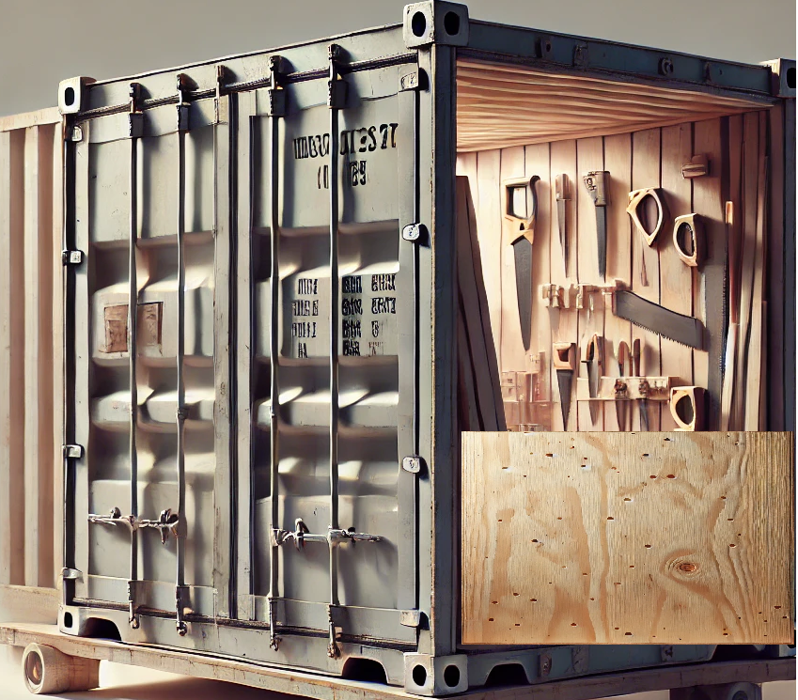
Why is my boat sinking?
When I lived in Ellensburg, there was a box trailer that was turned into a wood workshop and during the winter is was full on cold there. A propane guy came out and mentioned the holes – they were fairly small but he pointed out the fact that those wholes significantly reduce the temperature in the shop. You wouldn’t think such a minor thing wouldn’t throw the whole heating system out of whack, but it did just that! Our lives our the same way. When we entertain little pieces of fear, or what we think are small sins, it affects us in a big way. The holes I described in this story is like little door ways that if not plugged will get larger. A cuss word here, some lust of the eyes there, smoking substances - the lie that says, I only do this once in a while, it doesn’t matter. – how does God feel about what you are doing and what does the word say about it?

Slide 3
Why is my boat sinking?
Fear tolerated is faith contaminated
Contaminated faith is either weak or powerless.
James 3:11-12
11 Doth a fountain send forth at the same place sweet water and bitter?
12 Can the fig tree, my brethren, bear olive berries? either a vine, figs? so can no fountain both yield salt water and fresh.
Like Paul would say – God forbid! Or my brethren, this ought not be so

Slide 4
Why is my boat sinking?
Fear tolerated is faith contaminated
What little sin am I entertaining? In the old testament you had to keep the law in order to be blessed.
Although we are no longer under the law, sin of any kind small or big is not faith.
If you are not using faith, you will have a hard time keeping afloat.

Slide 5
Why is my boat sinking?
What big sin am I entertaining? If you are thinking about that sin (meaning doing it), you are not meditating in the word day and night – and you are not prospering and not having good success.
I have a friend (not local) that has been praying for a job – he came out of a relationship where he was living and having sex with a woman even though they were supposed to be married – he watches movies with cuss words (the inverse of Romans 10:17 - Fear comes by hearing, and hearing by the words of the devil – cussing is definitely hearing the words of the devil), and he cusses as well without regard, saying cussing doesn’t bother me – (Matthew 12:37 - by your words you are justified, by your words you are condemned), cuss words are condemning words – and he can’t figure out why he can’t find a job – his fountain is trying to bear both kinds of fruit – it doesn’t work.
What ever happened to John 15:7 - If ye abide in me, and my words abide in you, ye shall ask what ye will, and it shall be done unto you. Everything I have described above, is not abiding in Jesus.
Let me quote Rich Mullins for a moment: The Lord wasn’t joking when he kicked them out of Eden, it wasn’t for no reason that he shed his blood!
What if the sin(s) I am struggling with wasn’t on the list tonight – and its so heavy, I don’t know what to do?
Take a step of faith – say God, I need help, I am struggling with…
The Lord will help you – but you have to be willing to change. Keep confessing the word and come into agreement with what God says and thinks.

