Slide 1

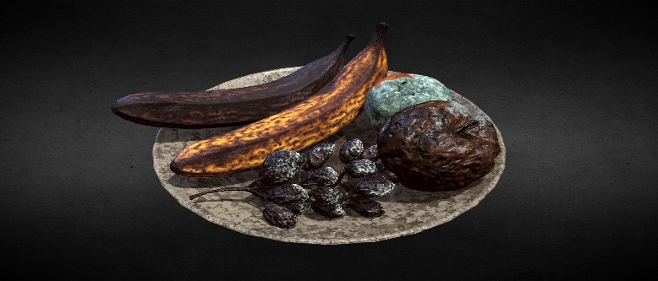
What kind of Fruit is your tongue producing?
Are you releasing words or faith or words of fear?
Applied Faith
Part 1
Proverbs 18:21
²¹ Death and life are in the power of the tongue: and they that love it shall eat the fruit thereof.
To Confess means to come into
agreement with
https://www.mathcompiler3d.com/bible-study

Slide 2


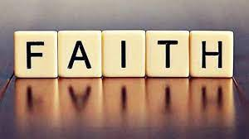

Step #1: How does Faith Work?
Faith Works by Love
Galatians 5:6
For in Jesus Christ neither circumcision availeth any thing, nor uncircumcision; but faith which worketh by love.
Remember what uncircumcised means
A stranger to the covenant of Promise
Without love
even the sign of the covenant has no meaning!

Slide 3
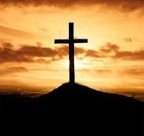
Applied Faith: Confess God’s word concerning love
God tells us how much he loved us
John 3:16
16 For God so loved the world, that he gave his only begotten Son, that whosoever believeth in him should not perish, but have everlasting life.
Scripture based Confession: For God so loved me, that he gave his only begotten Son for me, that if I believe in him, I would not perish but have everlasting life.
Often we find ourselves mentally ascending to the fact that God loves us but its not real to us on the inside. The more you confess John 3:16, the more your heart will become rooted and grounded in the love of God – since faith works by love, your faith will grow stronger.

Slide 4

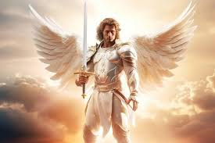
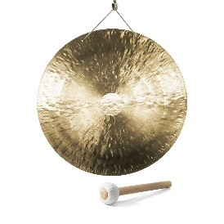
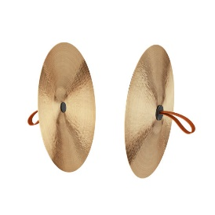
Step 2A: Understanding the nature of Love
Multiple languages without love does you no good
Praying in tongues without love, does you no good
A sounding brass or a tinkling cymbal at the wrong time really messes up the song
If you give “ALL” your goods to the poor, without love it profits nothing
Solomon level knowledge, without love – accomplishes nothing
Having faith to remove mountains – without love, means nothing
Even being a martyr – without love – profits nothing
1 Corinthians 13: 1-3
13 Though I speak with the tongues of men and of angels, and have not charity, I am become as sounding brass, or a tinkling cymbal.
² And though I have the gift of prophecy, and understand all mysteries, and all knowledge; and though I have all faith, so that I could remove mountains, and have not charity, I am nothing.
³ And though I bestow all my goods to feed the poor, and though I give my body to be burned, and have not charity, it profiteth me nothing.

Slide 5
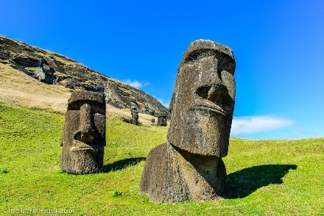
Step 2B: Understanding the nature of Love
Characteristics of Love
Is not puffed up – some similarities to the easter Island statues – (haughty means you act superior or look down on others)
Puffed up is a person who is proud and vain—who wants to make themselves appear or seem bigger and better than they are
Long suffering
Envies not
Vaunteth not itself - to boast or brag about something
Doesn’t behave in a way that it not fit
Does not look for its own benefit
Not easily provoked – it has a long fuse
Iniquity is immoral or grossly unfair behavior – [Loosed not the house of his prisoners]
Love rejoices in the truth
Bear all things – means to help carry a burden, or endure something
Love is never in unbelief
Love has a basis of hope – Hebrews 11:1
To endure all things is to remain in difficult situations for the sake of others
1 Corinthians 13: 4-7
⁴ Charity suffereth long, and is kind; charity envieth not; charity vaunteth not itself, is not puffed up,
⁵ Doth not behave itself unseemly, seeketh not her own, is not easily provoked, thinketh no evil;
⁶ Rejoiceth not in iniquity, but rejoiceth in the truth;
⁷ Beareth all things, believeth all things, hopeth all things, endureth all things.

Slide 6
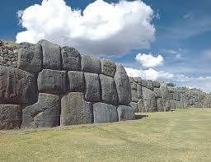
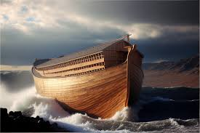

Step 2C: Understanding the nature of Love
Things other than love – will fail or vanish away
Prophecies fail, tongues cease, knowledge vanishes (Noah’s Ark – Preflood world knowledge – megalithic stone structures)
Love never fails
1 Corinthians 13: 8-13
⁸ Charity never faileth: but whether there be prophecies, they shall fail; whether there be tongues, they shall cease; whether there be knowledge, it shall vanish away.
⁹ For we know in part, and we prophesy in part.
¹⁰ But when that which is perfect is come, then that which is in part shall be done away.
¹¹ When I was a child, I spake as a child, I understood as a child,
I thought as a child: but when I became a man, I put away childish things.
¹² For now we see through a glass, darkly; but then face to face:
now I know in part; but then shall I know even as also I am known.
¹³ And now abideth faith, hope, charity, these three; but the greatest of these is charity.

Slide 7
Applied Faith: Confess God’s word concerning love
Scripture based Confession: I walk in love as Jesus has also love me. I am patient, I am kind, I am not envious of others. I do not think of myself more highly than I ought to think. As I practice walking in love towards others, I think on things are good, pure, lovely, just and of a good report.
Philippians 4:8
8 Finally, brethren, whatsoever things are true, whatsoever things are honest, whatsoever things are just, whatsoever things are pure, whatsoever things are lovely, whatsoever things are of good report; if there be any virtue, and if there be any praise, think on these things.
Romans 12:3
For I say, through the grace given unto me, to every man that is among you, not to think of himself more highly than he ought to think; but to think soberly, according as God hath dealt to every man the measure of faith.
Ephesians 5:1-2
Be ye therefore followers of God, as dear children;
2 And walk in love, as Christ also hath loved us, and hath given himself for us an offering and a sacrifice to God for a sweetsmelling savour.

Slide 8
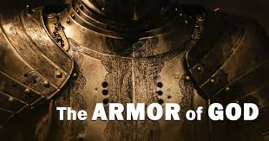

Applied Faith: Confess God’s word concerning righteousness
We wear the breast plate of righteousness
Establish yourself in righteousness
Confession: I am the righteousness of God in Christ
Ephesians 6:14
14 Stand therefore, having your loins girt about with truth, and having on the breastplate of righteousness;
What does it mean to be the righteous of God in Christ?
It means that you can now approach the presence of God, with no condemnation of sin
1 John 5:14-15
14 And this is the confidence that we have in him, that, if we ask any thing according to his will, he heareth us:
15 And if we know that he hear us, whatsoever we ask, we know that we have the petitions that we desired of him.
Hebrews 4:16
16 Let us therefore come boldly unto the throne of grace, that we may obtain mercy, and find grace to help in time of need.
2 Corinthians 5:21
For he hath made him to be sin for us, who knew no sin; that we might be made the righteousness of God in him.

Slide 9
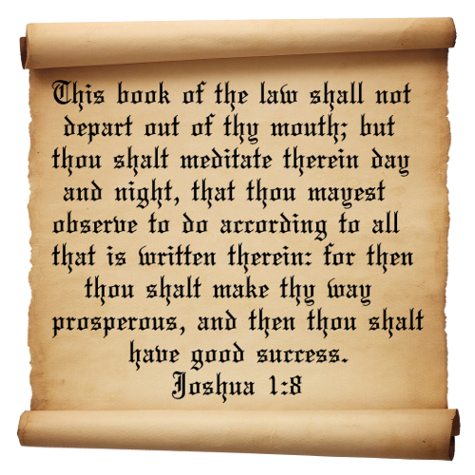
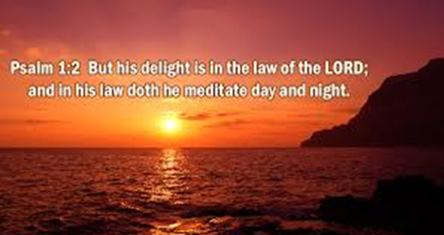
Applied Faith: Confess God’s word concerning Prosperity
What does God say about being prosperous?
Psalm 1: 1-3 - Personalized
1 I’m Blessed because I don’t walk in the counsel of the ungodly, I don’t standeth in the way of sinners, and I don’t sit in the seat of the scornful.
² I delight in the law of the Lord; and in his law do I meditate day and night.
³ I am like a tree planted by the rivers of water, I bring forth fruit in my season; my leaf does not wither; and whatsoever I do prospers.
Joshua 1:8-9 – Personalized
⁸ This book of the law does not depart out of my mouth; but I meditate therein day and night, that I may observe to do according to all that is written therein: for then I make thy way prosperous, and then I have good success.
⁹ Because God commanded me to do so: I am strong and I have good courage; I am not afraid, I am not dismayed: for the Lord my God is with me wherever I go.

Slide 10
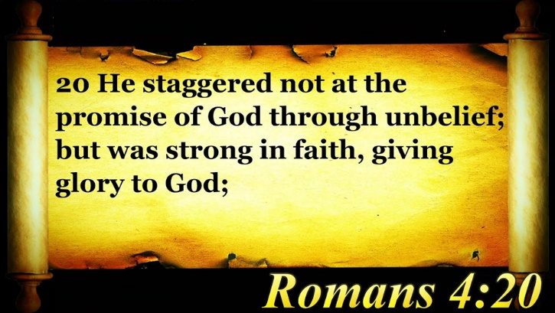
Applied Faith: Confess God’s word concerning Faith
Establish yourself in Faith
Confession: I stagger not at the promise of God, through unbelief, but I am strong in faith, and I give glory to God, because I believe that what he has promised me in his word, he is also able to perform.
Romans 4:20
20 He staggered not at the promise of God through unbelief; but was strong in faith, giving glory to God;

Slide 11
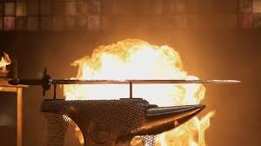
Applied Faith: Confess God’s word concerning Protection – 1A
Isaiah 54:17 Personalized
¹⁷ No weapon that is formed against me will prosper; and every tongue that shall rise against me in judgment thou shalt condemn. This is the heritage of the servants of the Lord, and their righteousness is of me, saith the Lord.

Slide 12
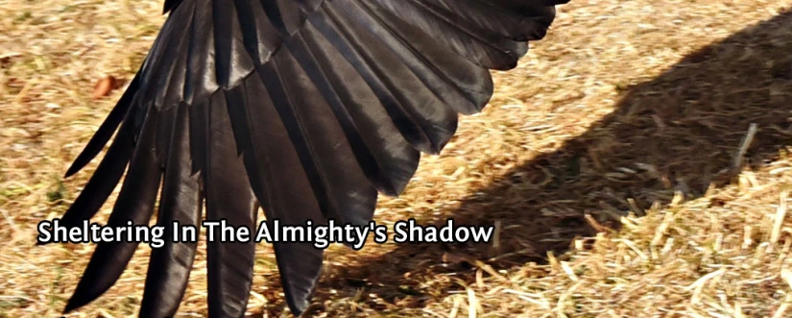
Applied Faith: Confess God’s word concerning Protection – 1B
Psalm 91:1-4 - Personalized
I dwell in the secret place of the most High and I abide under the shadow of the Almighty.
² I say of the Lord, He is my refuge and my fortress: my God; in him do I trust.
³ Surely he shall delivers me from the snare of the fowler, and from the noisome pestilence.
⁴ He covers me with his feathers, and under his wings do I trust: his truth is my shield and buckler.

Slide 13
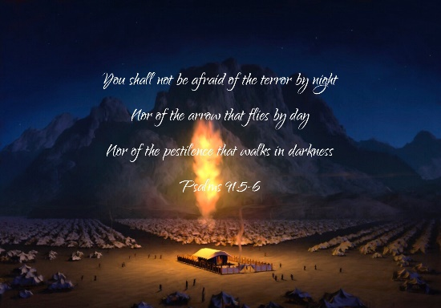
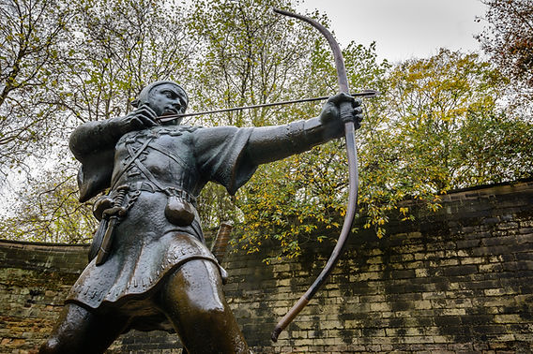
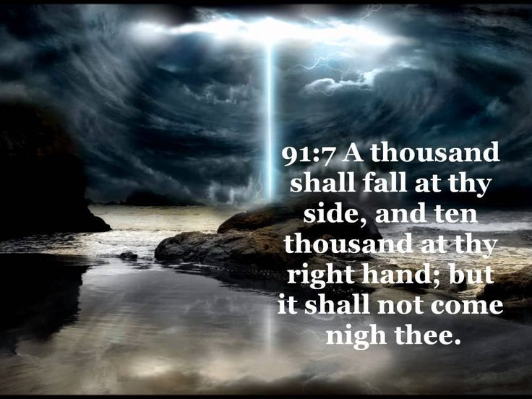
Applied Faith: Confess God’s word concerning Protection – 1C
Psalm 91:5-8 Personalized
⁵ I am not be afraid for the terror by night; nor for the arrow that flieth by day;
⁶ Nor for the pestilence that walketh in darkness; nor for the destruction that wasteth at noonday.
⁷ A thousand shall fall at my side, and ten thousand at my right hand; but it shall not come near me.
⁸ Only with my eyes shalt thou behold and see the reward of the wicked.

Slide 14
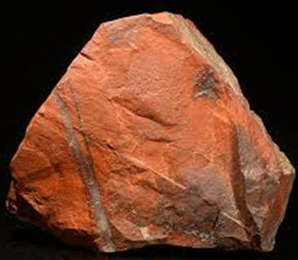
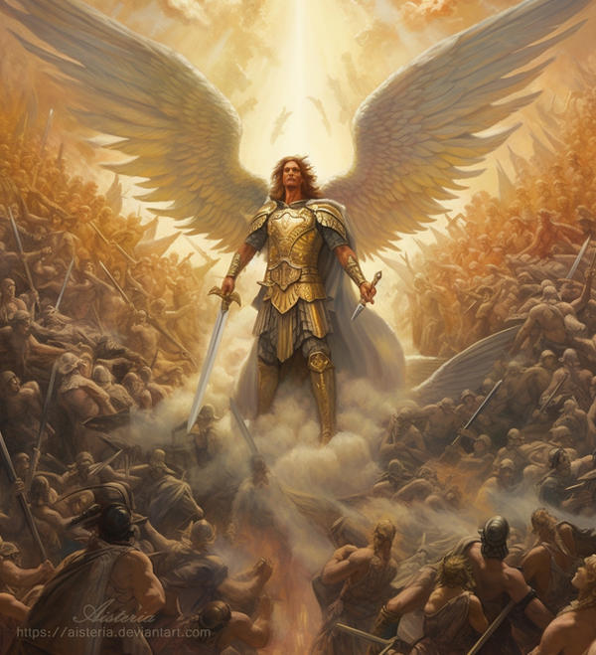
Applied Faith: Confess God’s word concerning Protection – 1D
Psalm 91:9-13 Personalized
⁹ Because I have made the Lord, which is my refuge, even the most High, my habitation;
¹⁰ There shall no evil befall me, neither shall any plague come nigh my dwelling.
¹¹ For he shall give his angels charge over me, to keep me in all thy ways.
¹² They shall bear me up in their hands, lest I dash thy foot against a stone.
¹³ I tread upon the lion and adder: the young lion and the dragon I trample under feet.

Slide 15
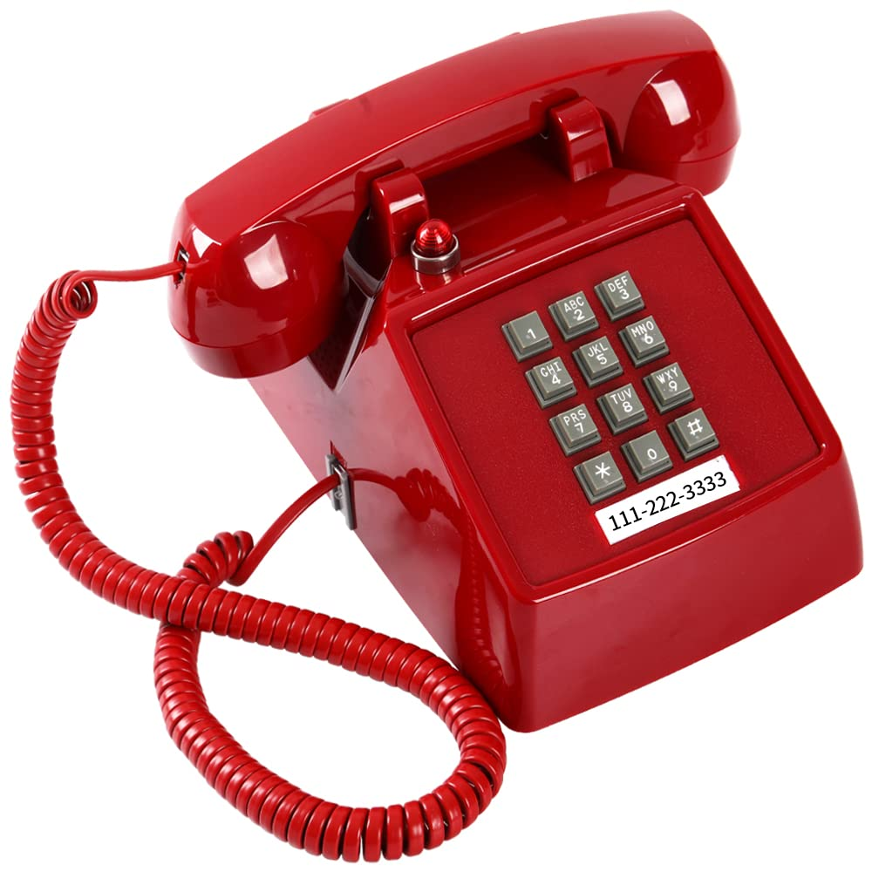
Applied Faith: Confess God’s word concerning Protection – 1E
You have the red phone on your desk – a direct hot-line to God – I call upon him and he answers me!
Psalm 91:14-16 Personalized
¹⁴ Because I hath set my love upon him, therefore he delivers me: He sets me on high, because I hath known his name.
¹⁵ I call upon him, and he will answer me: He is with me in trouble; he delivers me, and honor’s me.
¹⁶ With long life he satisfies me, and I show him my salvation.

Slide 16
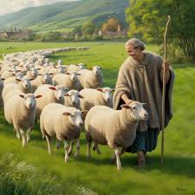

Applied Faith: Confess God’s word concerning Peace and Safety
Psalm 23 is already personalized
Psalm 23
23 The Lord is my shepherd; I shall not want.
² He maketh me to lie down in green pastures: he leadeth me beside the still waters.
³ He restoreth my soul: he leadeth me in the paths of righteousness for his name's sake.
⁴ Yea, though I walk through the valley of the shadow of death, I will fear no evil: for thou art with me; thy rod and thy staff they comfort me.
⁵ Thou preparest a table before me in the presence of mine enemies: thou anointest my head with oil; my cup runneth over.
⁶ Surely goodness and mercy shall follow me all the days of my life: and I will dwell in the house of the Lord for ever.

Slide 17
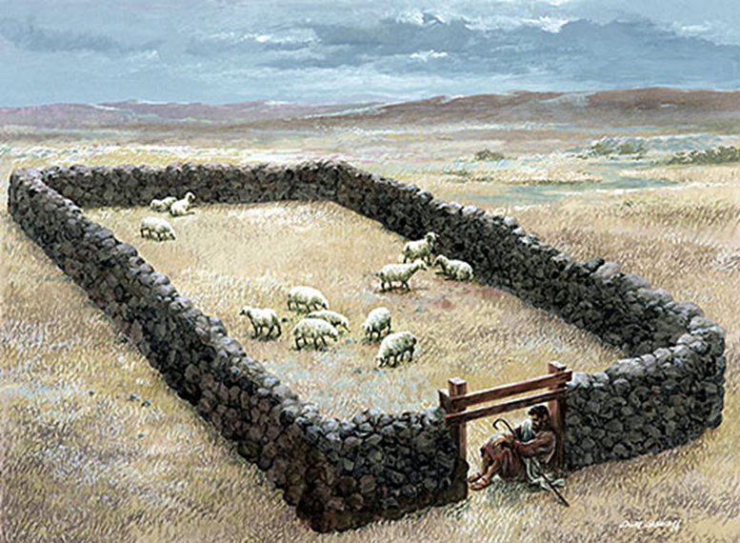
Understanding the Sheepfold
Confession: I can clearly hear the voice of God, and the voice of a stranger I flee from, and do not follow – Joseph fled from the stranger when Potiphar’s wife came to him
John 10:1-5
Verily, verily, I say unto you, He that entereth not by the door into the sheepfold, but climbeth up some other way, the same is a thief and a robber.
² But he that entereth in by the door is the shepherd of the sheep.
³ To him the porter openeth; and the sheep hear his voice: and he calleth his own sheep by name, and leadeth them out.
⁴ And when he putteth forth his own sheep, he goeth before them, and the sheep follow him: for they know his voice.
⁵ And a stranger will they not follow, but will flee from him: for they know not the voice of strangers.

Slide 18
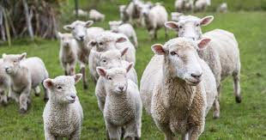
Applied Faith: Confess God’s word concerning Freedom from fear
Isaiah 54:14
14 In righteousness shalt thou be established: thou shalt be far from oppression; for thou shalt not fear: and from terror; for it shall not come near thee.
2 Timothy 1:7
⁷ For God hath not given us the spirit of fear; but of power, and of love, and of a sound mind.
Confession: I know the voice of the Lord, and no one can pluck me out of his hand
Applied Faith: Confess God’s word concerning hearing the voice of God
John 10:27-28
²⁷ My sheep hear my voice, and I know them, and they follow me:
²⁸ And I give unto them eternal life; and they shall never perish, neither shall any man pluck them out of my hand.

Slide 19
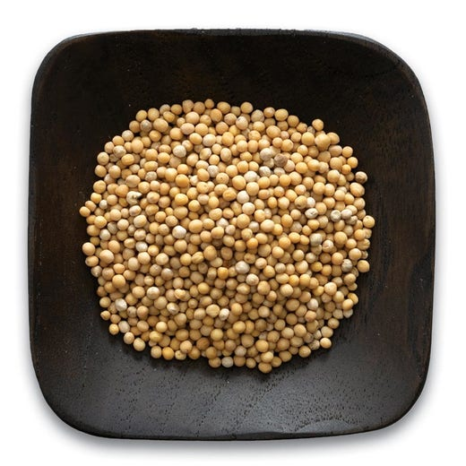
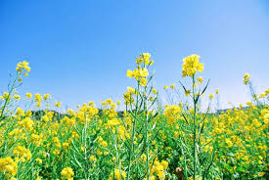
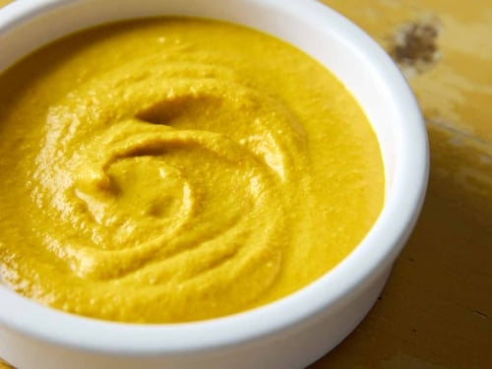
Applied Faith: How to increase your Faith
Continuously speak God’s word over the problem and your faith will grow
Luke 17:5-6
⁵ And the apostles said unto the Lord, Increase our faith.
⁶ And the Lord said, If ye had faith as a grain of mustard seed, ye might say unto this sycamine tree, Be thou plucked up by the root, and be thou planted in the sea; and it should obey you.

Slide 20
Be a doer of the word and not a hearer only
You must speak and believe
the word of God to see results in your life
James 1:22-25
22 But be ye doers of the word, and not hearers only, deceiving your own selves.
23 For if any be a hearer of the word, and not a doer, he is like unto a man beholding his natural face in a glass:
24 For he beholdeth himself, and goeth his way, and straightway forgetteth what manner of man he was.

