Slide 1
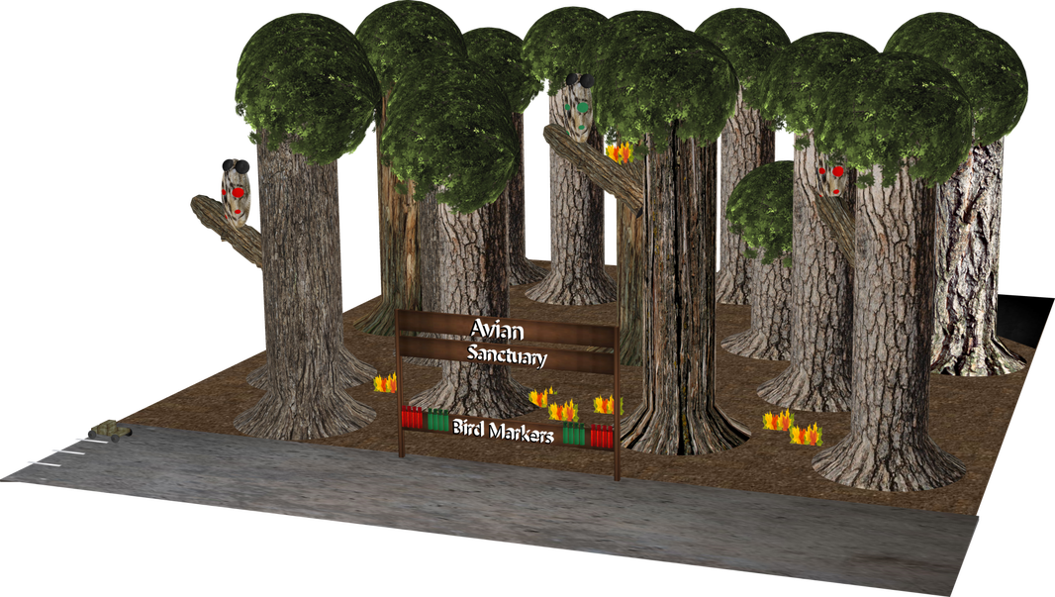
Genesis and a message through time
The adventures of Joe & Fred
Joe
Hey Fred,
I hear the spotted owl hangs out in this sanctuary! Have you seen any yet?
Fred
Yes, as a matter of fact -
I spotted that owl,
and I spotted that owl,
and I spotted that owl over there too!
https://www.mathcompiler3d.com/bible-study

Slide 2
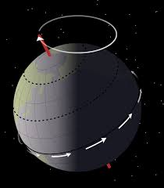
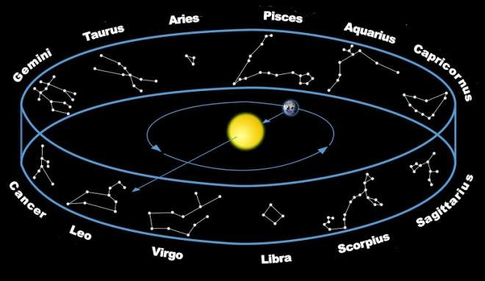
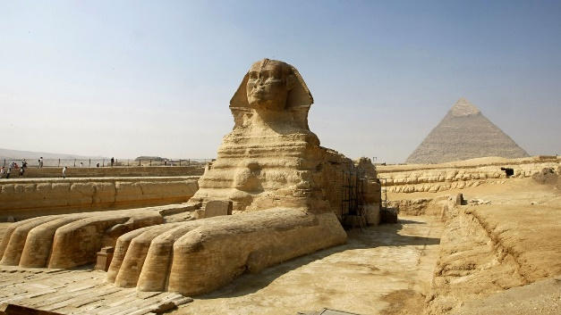
Precession
Each cycle has ~ 2160 years
There is a 29,520 year cycle for the earth to pass through all of the constellations
The Sphinx is the hour hand of the clock
Precession is the slow, gradual movement of the axis of a rotating object, such as a spinning top, a gyroscope, or a planet, as it wobbles in response to external forces. This motion causes the orientation of the rotational axis to trace out a circular or elliptical path over time.
The Sphinx is a giant hand of a clock showing where we are in the procession of the 29,520 year cycle. The monuments were built to point to cycles of destruction / extinction events – like a pole shift.

Slide 3
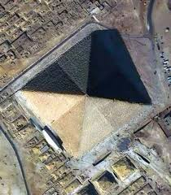
The Great Pyramid
A scale model of the Earth
Original Specs:
Volume = 91,155,780.93 [Cu Ft]
Area = 569,311.8608 [Sq Ft]
Perimeter: 3,018.110298 [Ft]
Side Length: 754.5275745 [Ft]
C/H Ratio: 6.283185307 [2 PI]
Slope: 51.85397361°
Height = 480.3471728 Ft
It also encoded the speed of light & the circumference of the equator

Slide 4
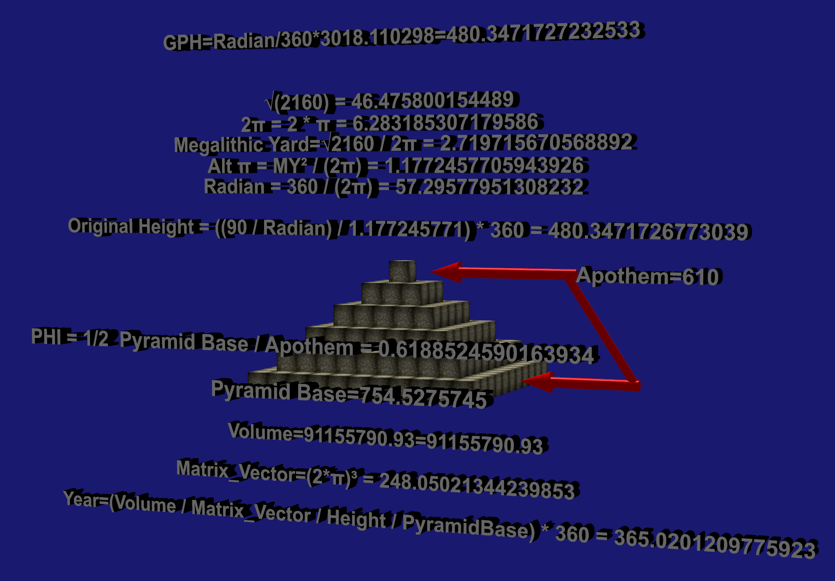
The Great Pyramid
A scale model of the Earth – 3D

Slide 5
End Times & Pre-Times: The Evening and the morning
I am God – there is none like me
God declares the end from the beginning
God didn’t have a creator
Isaiah 46:9 – 10
⁹ Remember the former things of old: for I am God, and there is none else; I am God, and there is none like me,
¹⁰ Declaring the end from the beginning, and from ancient times the things that are not yet done, saying, My counsel shall stand, and I will do all my pleasure:

Slide 6
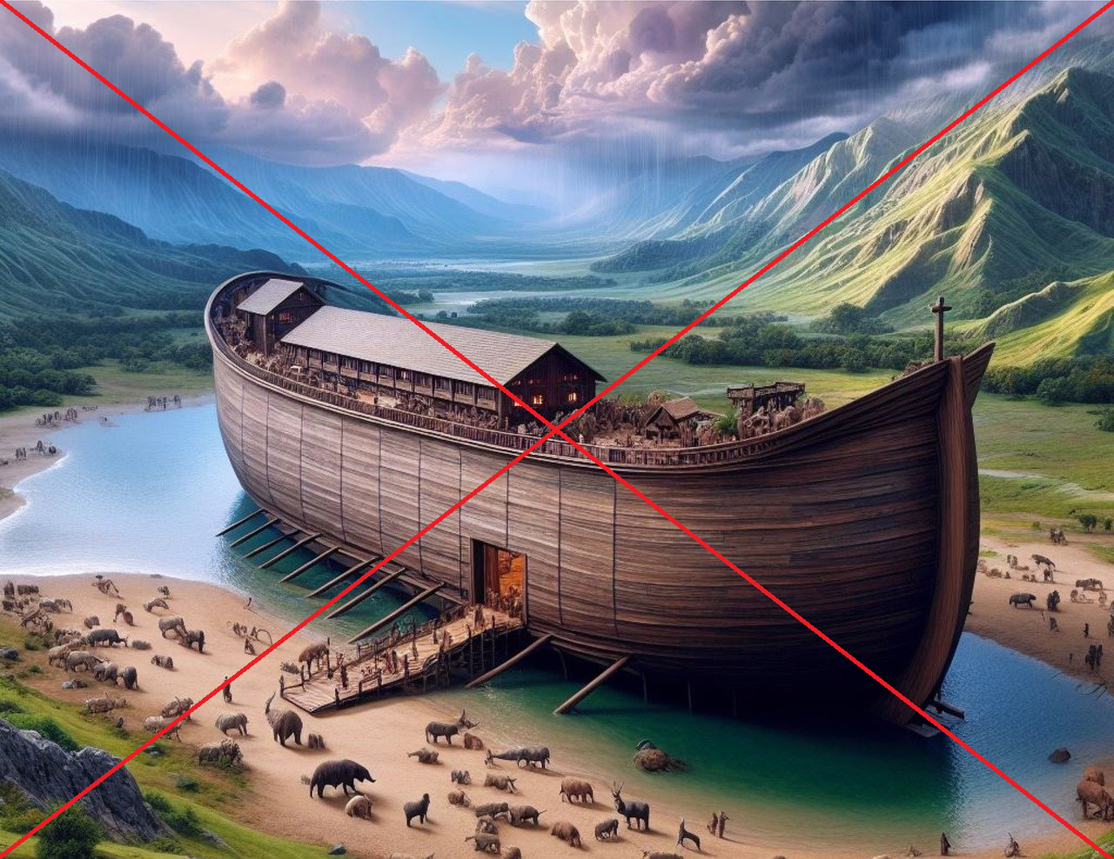
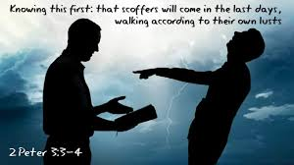
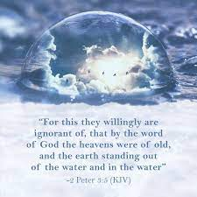
End Times & Pre-Times:
Where is the promise
of his coming?
Vs. 4 - Scoffers say, where is the Promise of his coming?
Vs 5 - They are willing ignorant that the heavens were of old
Vs 5 – The earth was standing out of the water and in the water
Vs 8 - A day with the Lord is like a thousand years – be not ignorant of this!
Vs 9 – The Lord is not slack concerning his promises
2 Peter 3:1-5
This second epistle, beloved, I now write unto you; in both which I stir up your pure minds by way of remembrance:
² That ye may be mindful of the words which were spoken before by the holy prophets, and of the commandment of us the apostles of the Lord and Saviour:
³ Knowing this first, that there shall come in the last days scoffers, walking after their own lusts,
⁴ And saying, Where is the promise of his coming? for since the fathers fell asleep, all things continue as they were from the beginning of the creation.
⁵ For this they willingly are ignorant of, that by the word of God the heavens were of old, and the earth standing out of the water and in the water:

Slide 7
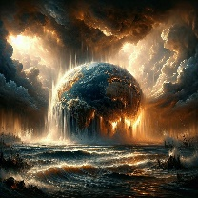
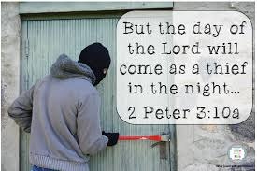
End Times & Pre-Times:
Where is the promise
of his coming?
Vs. 6 – The world that then was, perished
Vs 7 – The world will last until its destroyed by fire
Vs 8 - A day with the Lord is like a thousand years – be not ignorant of this!
Vs 9 – The Lord is not slack concerning his promises
Vs 10 – The day of the Lord will come as a thief in the night
2 Peter 3:6-13
⁶ Whereby the world that then was, being overflowed with water, perished:
⁷ But the heavens and the earth, which are now, by the same word are kept in store, reserved unto fire against the day of judgment and perdition of ungodly men.
⁸ But, beloved, be not ignorant of this one thing, that one day is with the Lord as a thousand years, and a thousand years as one day.
⁹ The Lord is not slack concerning his promise, as some men count slackness; but is longsuffering to us-ward, not willing that any should perish, but that all should come to repentance.
¹⁰ But the day of the Lord will come as a thief in the night; in the which the heavens shall pass away with a great noise, and the elements shall melt with fervent heat, the earth also and the works that are therein shall be burned up.
¹¹ Seeing then that all these things shall be dissolved, what manner of persons ought ye to be in all holy conversation and godliness,
¹² Looking for and hasting unto the coming of the day of God, wherein the heavens being on fire shall be dissolved, and the elements shall melt with fervent heat?
¹³ Nevertheless we, according to his promise, look for new heavens and a new earth, wherein dwelleth righteousness.

