Slide 1
Introduction to Hope – The Foundation of Faith
The first step of hope is to put God’s Word in your heart
Psalm 119:11
¹¹ Thy word have I hid in mine heart
Hope Part #1
Habakkuk 2:2
² And the Lord answered me, and said, Write the vision, and make it plain upon tables, that he may run that readeth it.
This is the very definition of Hope – God thinks thoughts towards you, thoughts up peace! God is on our side! Hope comes directly from God
Jeremiah 29:11
¹¹ For I know the thoughts that I think toward you, saith the Lord, thoughts of peace, and not of evil, to give you an expected end.
The result of putting Gods word in your heart introduces the light of revelation – If you have the revelation of what the word of God means (referring to specific scriptures that cover your situation) – the Devil will not be able to steel the word from your heart that was sown. Mark 4:15
Psalm 119:130
130 The entrance of thy words giveth light; it giveth understanding unto the simple.
https://www.mathcompiler3d.com/bible-study

Slide 2
Introduction to Hope – The Foundation of Faith
How Hope Words – Patience to Experience – Experience to Hope and Hope To Faith – and Faith to the materialization in the natural world of your answer
We are blessed when we put our hope in the Lord
Jeremiah 17:7
⁷ Blessed is the man that trusteth in the Lord, and whose hope the Lord is.
The Lord’s compassions fail not – they renew every morning – therefore we hope in him
Lamentations 3:20-24
²² It is of the Lord's mercies that we are not consumed, because his compassions fail not.
²³ They are new every morning: great is thy faithfulness.
²⁴ The Lord is my portion, saith my soul; therefore will I hope in him.
Both Patience and Experience produce hope – hope is required for faith, and faith becomes the substance of things hoped for, the evidence of things not seen
Romans 5:3-5
³ And not only so, but we glory in tribulations also: knowing that tribulation worketh patience;
⁴ And patience, experience; and experience, hope:
⁵ And hope maketh not ashamed; because the love of God is shed abroad in our hearts by the Holy Ghost which is given unto us.

Slide 3
Introduction to Hope – The Foundation of Faith
The Issues of Life
If you have lost your issues of life – repair them by filling your heart with Godly hope (Proverbs 4:23: Keep thy heart with all diligence; for out of it are the issues of life.)
Proverbs 13:12
² Hope deferred maketh the heart sick: but when the desire cometh, it is a tree of life.
Patience is required to be perfect and entire – wanting nothing
James 1:4
⁴ But let patience have her perfect work, that ye may be perfect and entire, wanting nothing.
Without wavering – Abraham staggard not at the promise of God – he didn’t waver
Hebrews 10:23
²³ Let us hold fast the profession of our faith without wavering; (for he is faithful that promised;)

Slide 4
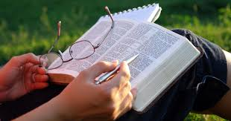
Introduction to Hope – The Foundation of Faith
Let them not depart from thine eyes
Feed faith in through your eyes by reading the scripture – (preferably out loud) – its like eating fresh food in the natural, but it translates to eating fresh spiritual food.
Always look to the Lord for direction when praying about something you desire
Proverbs 16:9
⁹ A man's heart deviseth his way: but the Lord directeth his steps.
Proverbs 4:20-23
²⁰ My son, attend to my words; incline thine ear unto my sayings.
²¹ Let them not depart from thine eyes; keep them in the midst of thine heart.
²² For they are life unto those that find them, and health to all their flesh.
²³ Keep thy heart with all diligence; for out of it are the issues of life.
Always Partner with Jesus when you use your faith that your hope is based on
Hebrews 12:2
² Looking unto Jesus the author and finisher of our faith; who for the joy that was set before him endured the cross, despising the shame, and is set down at the right hand of the throne of God.

Slide 5
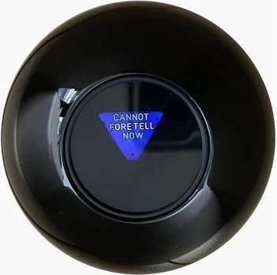
Introduction to Hope – The Foundation of Faith
Commit thy works unto the Lord
Proverbs 16:3
³ Commit thy works unto the Lord, and thy thoughts shall be established.
Commit means to Pledge or to Bind a certain course or policy
Doubt starts in the mind – don’t speak it or think it – Peter beginning to doubt, started to sink – if your thoughts are established, your faith won’t leave in degrees. How are your thoughts established – by committing your works until the Lord. (Proverbs 3:5-6 ⁵ Trust in the Lord with all thine heart; and lean not unto thine own understanding.⁶ In all thy ways acknowledge him, and he shall direct thy paths.) – Don’t lose hope – keep speaking the word.
Our Hope is in the Lord
Strengthen your heart: this means to make your spirit strong (Ex. Jude 20 - But ye, beloved, building up yourselves on your most holy faith, praying in the Holy Ghost)
Courage is the willingness to face pain, danger, uncertainty, or intimidation, and to make good choices in the face of fear or obstacles.
God will strength your heart – never be afraid to say, Lord I believe, help my unbelief.
Psalm 31:24
²⁴ Be of good courage, and he shall strengthen your heart, all ye that hope in the Lord.

Slide 6
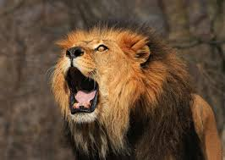
Introduction to Hope – The Foundation of Faith
Don’t let your soul stay in a down cast state – or hope will leak out
There is a song we sing in church – praise will take your focus off of the problem, and turn your eyes to Jesus – when your eyes are on Jesus, you don’t sink when walking on water – and when your believing God for an answer to prayer, through praise it will keep you from sinking.
We choose to praise God regardless of our feelings
Hebrews 13:15
¹⁵ By him therefore let us offer the sacrifice of praise to God continually, that is, the fruit of our lips giving thanks to his name.
So come on, my soul Oh, don't you get shy on me Lift up your song 'Cause you've got a lion inside of those lungs Get up and praise the Lord
God doesn’t want you to just hope, he wants you to abound in hope – abounding in hope is exciting – if you are abounding in hope – faith has a wider foundation to grow on.
Romans 15:13
¹³ Now the God of hope fill you with all joy and peace in believing, that ye may abound in hope, through the power of the Holy Ghost.
If praising God is difficult – find a praise song that allows you to identify and connect to God. Start with a mind set of praise – let the Holy Spirit do the work as you listen to the song – it doesn’t have to be difficult – it can start as an act of obedience [the sacrifice of praise].

Slide 7
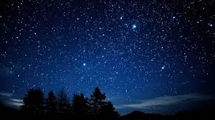
Introduction to Hope – The Foundation of Faith
It takes Strength to have both Hope and Faith
It takes strength to have both hope and faith – waiting on the Lord is not sitting still, its an active waiting – you keep professing the Word – When you’ve done all to stand, stand therefore – but keep the word flowing out of your mouth by speaking in faith the desired end result. You are not waiting on God – God is waiting on you to speak the Word in Faith that your hope is based on. If your strength is renewed, you won’t quit before the answer comes.
Isaiah 40:31
³¹ But they that wait upon the Lord shall renew their strength; they shall mount up with wings as eagles; they shall run, and not be weary; and they shall walk, and not faint.
Abraham had hope in the face of no natural evidence – but he choice to hope in the promise of God – giving a foundation for his faith – and he receive his promise.
Romans 4:18
¹⁸ Who against hope believed in hope, that he might become the father of many nations, according to that which was spoken, So shall thy seed be.

Slide 8
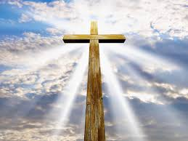
The Greatest Hope of All
We are preserved blameless unto the coming of our Lord Jesus Christ
1 Thessalonians 5:23
²³ And the very God of peace sanctify you wholly; and I pray God your whole spirit and soul and body be preserved blameless unto the coming of our Lord Jesus Christ.
My hope restored
I raise my eyes
To praise the Lord alone
And give thanks to God almighty
He’s not dead but on the throne
When you find yourself low on hope go back to the beginning and restore your hope
John 3:16 – For God so loved the World
John 10:10 – I have come that you might have life
3 John 2 – I wish above all things
John 1:12-13 – To them he gave the power to become the sons of God
Mark 9:24 – Lord I believe – Help my unbelief

Slide 9
Discussion Questions
What is the first step of hope?
What is should not depart from thine eyes?
What does the entrance of God’s word give?
Where do the issues of life come from?
Complete the first part of the verse – that he may run that readeth it.
After a man’s heart devised his way: what does the Lord direct?
What kinds of thoughts does the Lord think towards us?
Who is the author and the finisher of our faith?
When we put our hope in the Lord - what happens?
What does it take for your thoughts to be established?
What do tribulation, patience, and experience produce?
What are the results of waiting on the Lord?
Why does hope make us not ashamed?
What 3 things are preserved blameless unto the coming of our Lord Jesus Christ?
What makes the heart sick?
What is required to be perfect and entire, wanting nothing?

