Slide 1
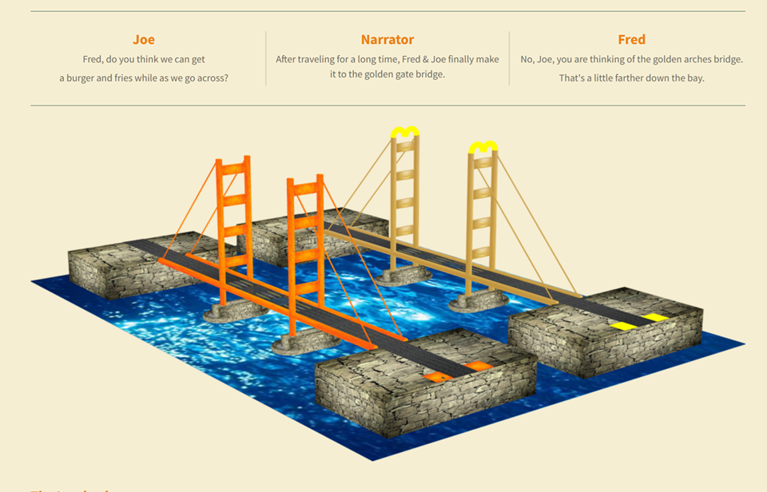
Fruits of the Spirit – Part – 2 - Humor

Slide 2
Fruits of the Spirit – Part 2
Discussion Questions
What are the tongues of angles?
What value is equated to those who can remove mountains but have not love?
What are the 3 things which abide and which is the greatest?
What does it mean to walk in love?
How do we walk in love?
Define that which is in part
What are you supposed to rejoice in?
What are you not supposed to rejoice in?
Who doesn’t know God?
What does it mean to bear fruit?
Which fruit of the spirit never fails?
What happens to knowledge?
What doesn’t behave itself un-seemingly?
What should evil be overcome with?
What did Jesus do after he was anointed with the Holy Ghost and power?
What did God before ordain that we should walk there in?
Who is the only one Jesus called good?
What happened to those who were oppressed of the devil?
What is the requirement for ever lasting life?
Name the amount of shekels you will earn for saying depart in peace and be warm without providing what is needed for that to happen?
Who shall inherit the earth?
How often should you forgive someone if you had to put a # on it?
To Faith Add virtue – to virtue add knowledge – to knowledge add what?
How should the servant of the Lord treat all men?

Slide 3
1 Corinthians 13:1-5
Fruits of the Spirit – Part - 2
1 Corinthians 13:6-10
13 Though I speak with the tongues of men and of angels, and have not charity, I am become as sounding brass, or a tinkling cymbal.
2 And though I have the gift of prophecy, and understand all mysteries, and all knowledge; and though I have all faith, so that I could remove mountains, and have not charity, I am nothing.
3 And though I bestow all my goods to feed the poor, and though I give my body to be burned, and have not charity, it profiteth me nothing.
4 Charity suffereth long, and is kind; charity envieth not; charity vaunteth not itself, is not puffed up,
5 Doth not behave itself unseemly, seeketh not her own, is not easily provoked, thinketh no evil;
6 Rejoiceth not in iniquity, but rejoiceth in the truth;
7 Beareth all things, believeth all things, hopeth all things, endureth all things.
8 Charity never faileth: but whether there be prophecies, they shall fail; whether there be tongues, they shall cease; whether there be knowledge, it shall vanish away.
9 For we know in part, and we prophesy in part.
10 But when that which is perfect is come, then that which is in part shall be done away.
There are 9 fruits of Spirit that we should exhibit in our lives on a daily basis
Galatians 5:22-23
22 But the fruit of the Spirit is love, joy, peace, longsuffering, gentleness, goodness, faith,
23 Meekness, temperance: against such there is no law.
"To bear fruit" is an idiom that means to produce successful results, especially after putting in a lot of effort. Its something that is shown and that you are partake in or provide benefit from.
1 Corinthians 13:11-13
11 When I was a child, I spake as a child, I understood as a child, I thought as a child: but when I became a man, I put away childish things.
12 For now we see through a glass, darkly; but then face to face: now I know in part; but then shall I know even as also I am known.
13 And now abideth faith, hope, charity, these three; but the greatest of these is charity.
John 15:8
Herein is my Father glorified, that ye bear much fruit; so shall ye be my disciples.
1 John 4:8 - He that loveth not knoweth not God; for God is love.
Ephesians 5:1-2
5 Be ye therefore followers of God, as dear children;
2 And walk in love, as Christ also hath loved us, and hath given himself for us an offering and a sacrifice to God for a sweetsmelling savour.

Slide 4
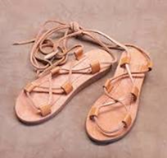
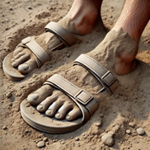
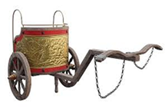
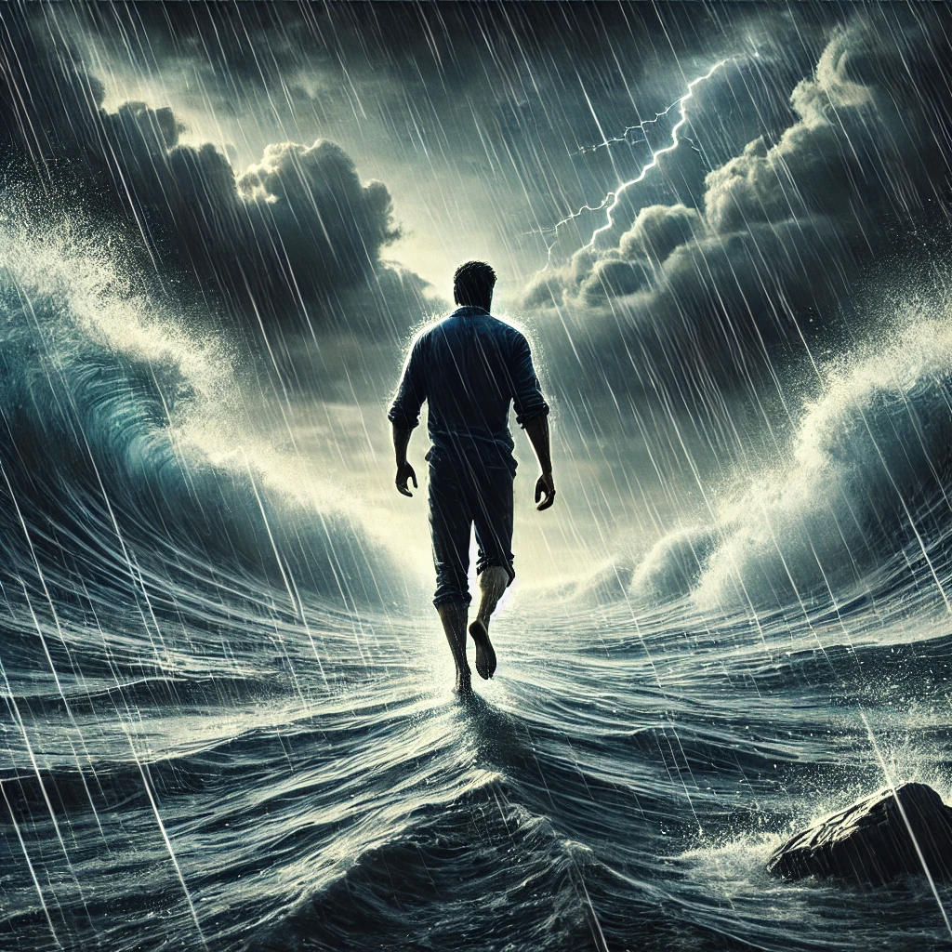
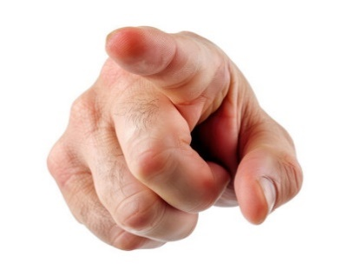
Faith Commercial – God’s clean feet services
Do your feet get tired of walking in sandals?
Is the dust between your toes getting to be just too much?
Is the bumpy ride of a chariot around the lake just not filling the bill anymore?
Then do I have the deal for you!
For just 1 mustard seed of Faith
You can purchase God’s clean feet services. Take a refreshing stroll that reduces the extra miles and eliminates your bumpy ride. No more pesky dusk to discard at the end of your trip. Your feet will feel wonderful. Wind and waves are of no consequence. Optional Packages include: Ability to comfort fearful fellows in a boat, saving someone from sinking, and renouncing the title of: Oh Ye of little faith.
Yes, how beautiful are the feet of them that preach the gospel of peace will have a whole new meaning. You too, can walk on the water with God’s clean feet services!
We now return to your regularly scheduled Bible study

