Slide 1
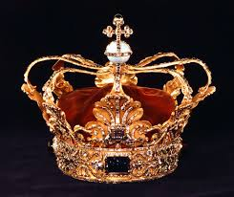
The people imagine a vain thing
Psalm 2:1
Why do the heathen rage, and the people imagine a vain thing?
Isaiah 14:13-14 – Knows he can’t win – what changed??
The dark side all of a sudden thinks they can win – exactly what kind of weapons have they created that they think they can default God with?
Vain – Producing no result, useless
(What time period are we in?)
Psalm 2:2
The kings of the earth set themselves, and the rulers take counsel together, against the Lord, and against his anointed, saying,
Psalm 2:3
Let us break their bands asunder, and cast away their cords from us.
Why do the Heathen Rage #1

Slide 2
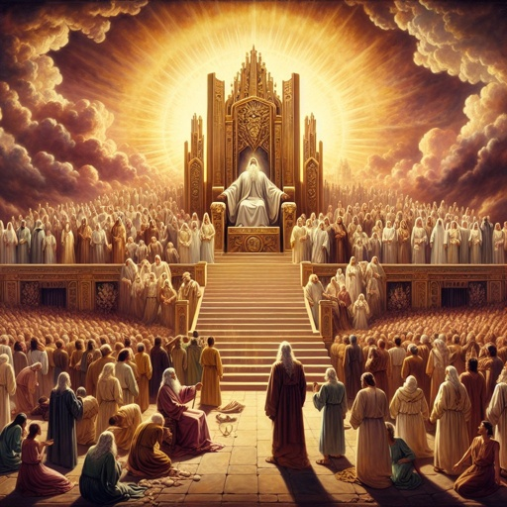
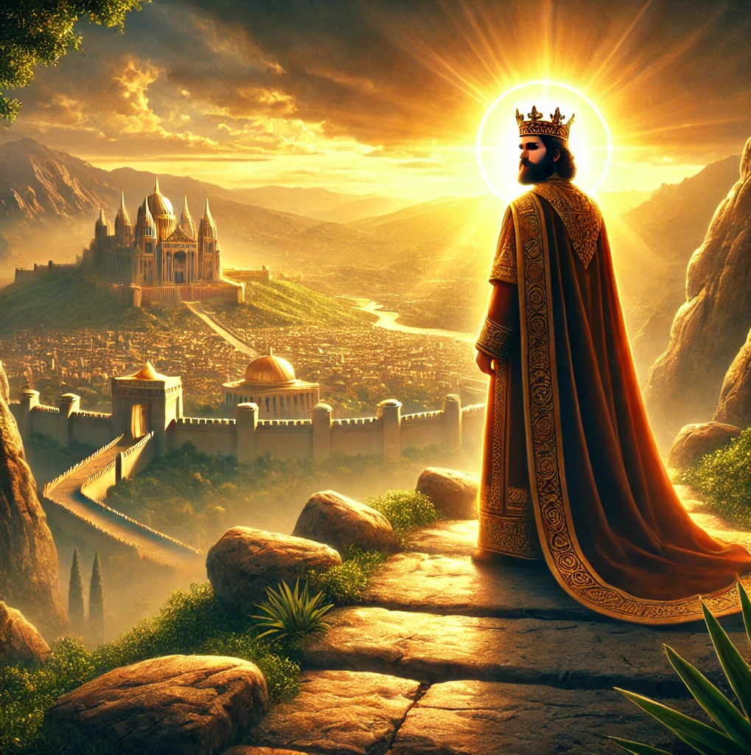
Then shall he speak to them in his wrath
4 He that sitteth in the heavens shall laugh: the Lord shall have them in derision.
5 Then shall he speak unto them in his wrath, and vex them in his sore displeasure.
Psalm 2:5-7
6 Yet have I set my king upon my holy hill of Zion.
7 I will declare the decree: the Lord hath said unto me, Thou art my Son; this day have I begotten thee.
Hebrews 1:5 For unto which of the angels said he at any time, Thou art my Son, this day have I begotten thee? And again, I will be to him a Father, and he shall be to me a Son?

Slide 3
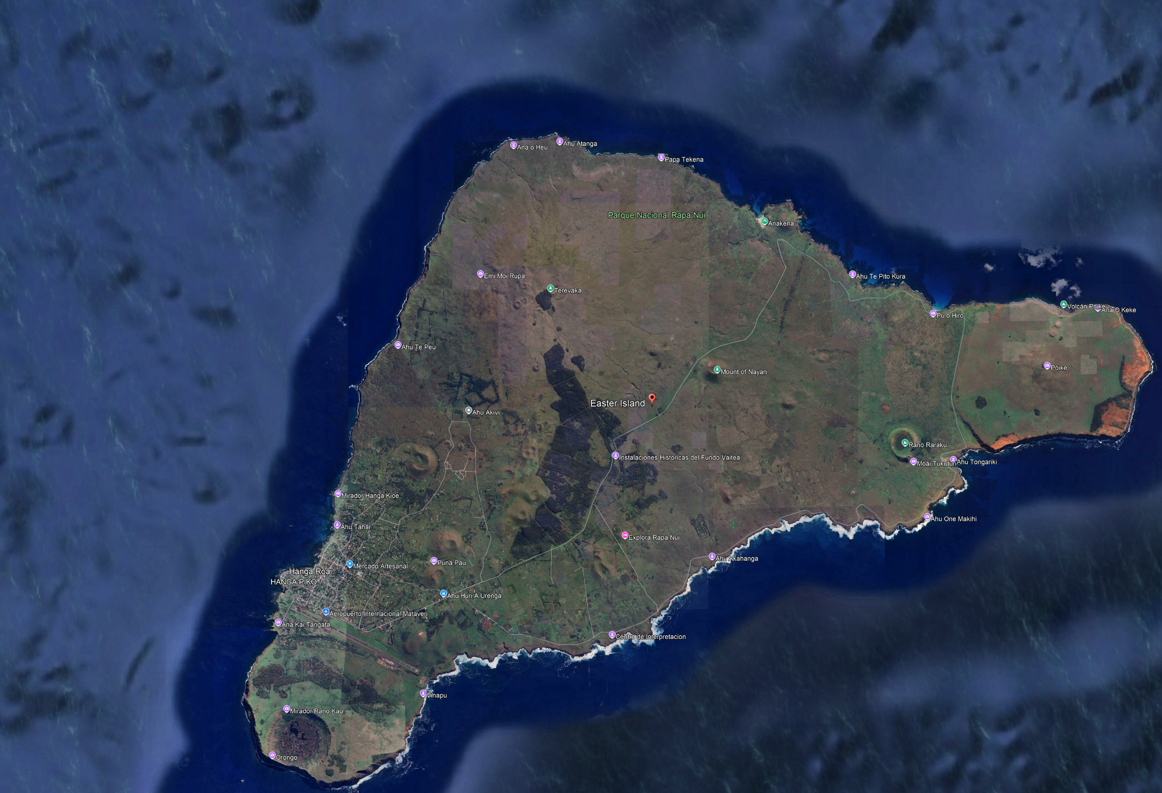
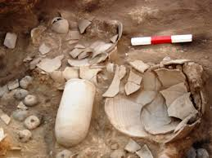
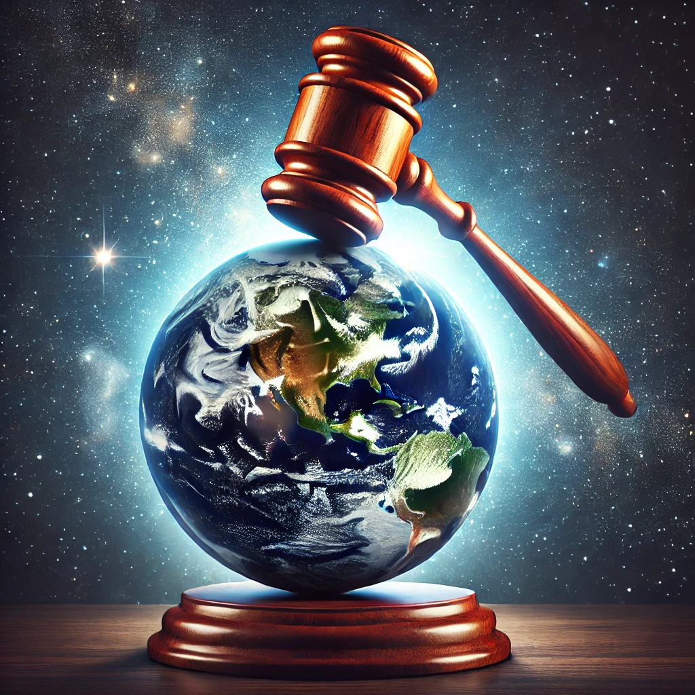
Thou art my Son, this day have I begotten thee
Psalm 2:8 Ask of me, and I shall give thee the heathen for thine inheritance, and the uttermost parts of the earth for thy possession.
Psalm 2:9 Thou shalt break them with a rod of iron; thou shalt dash them in pieces like a potter's vessel.
Revelation 2:27 And he shall rule them with a rod of iron; as the vessels of a potter shall they be broken to shivers: even as I received of my Father.
Psalm 2:10-12 Be wise now therefore, O ye kings: be instructed, ye judges of the earth.
11 Serve the Lord with fear, and rejoice with trembling.
12 Kiss the Son, lest he be angry, and ye perish from the way, when his wrath is kindled but a little. Blessed are all they that put their trust in him.

