Slide 1
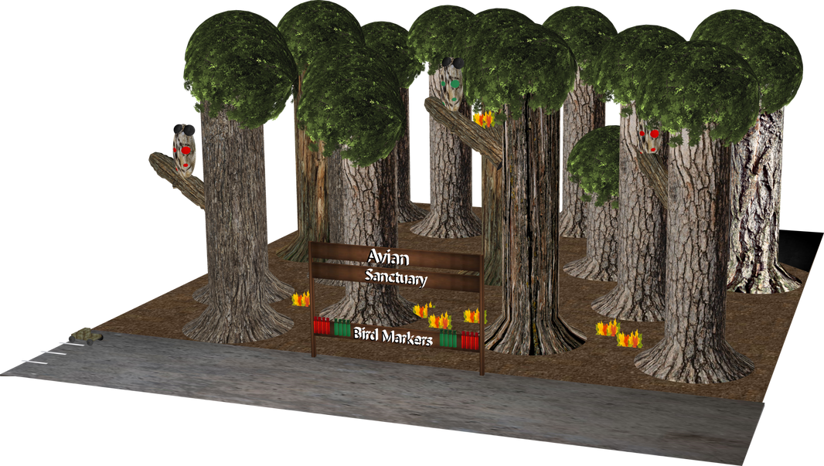
A MESSAGE THROUGH TIME
The adventures of Joe & Fred
Joe
Hey Fred,
I hear the spotted owl hangs out in this sanctuary! Have you seen any yet?
Fred
Yes, as a matter of fact -
I spotted that owl,
and I spotted that owl,
and I spotted that owl over there too!
https://www.mathcompiler3d.com/bible-study

Slide 2
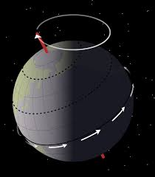
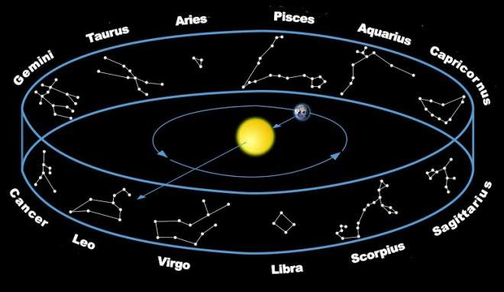
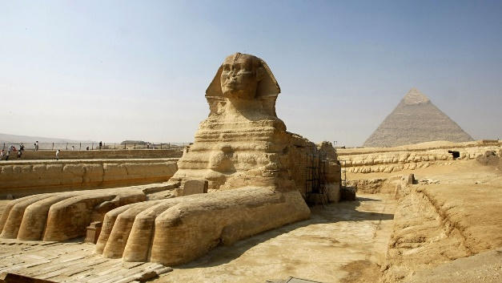
Precession
Each cycle has ~ 2160 years
There is a 26,000 year cycle for the earth to pass through all of the constellations
The Sphinx is the hour hand of the clock
Precession is the slow, gradual movement of the axis of a rotating object, such as a spinning top, a gyroscope, or a planet, as it wobbles in response to external forces. This motion causes the orientation of the rotational axis to trace out a circular or elliptical path over time.

Slide 3
The Message – Part 1
A Hidden Message
A message through time has been the hardest concept for me to wrap my head around. If you have seen the video revelation of the pyramids it talked about an ancient civilization sending a message in stone through time to warn us who are in the future. There are legends that say that either Adam or Enoch commissioned two monuments through time to warn people - one if the world was destroyed by water and another if by fire. The interesting thing is I have only heard of this legend once. It may be true but usually there are at least a fair amount of breadcrumbs you can follow on a subject as big as this. One possibility is that the story or the evidence was passed down by word of mouth instead of a written format. Noah's flood would have taken care of most of the evidence except for large stone monuments.

Slide 4
The Message – Part 2
We live in a world where good and evil are constantly at war. I have a hard time believing that the "dark" side would ever warn future humans of impending catastrophe. Evil is not always logical. Take the example in the Bible (Mark 9:14 - 29) where Jesus heals the boy possessed by a spirit who often would throw him into the fire or the water to kill him. To me, the action of the demon does not make logical spirit. The demon is a disembodied spirit of a giant from Genesis 6 which died in the flood. If this demon doesn't have a physical body, then we don't have power to operate in the earth unless a human gives it to him - then if I was a demon (and I assure you I am not), I would be thrilled to have a body where I could express myself in the natural 3D world. Now keep in mind that demon possession is awful, and I am not making light of it. I'm just trying to illustrate a point. Based on that concept, that's why I said that I have a hard time believing that the dark side would warn anybody - current or future.

Slide 5
The Message – Part 3
There might be one exception. If I was a master of deception I might construct and elaborate scheme to deceive you. If the stakes were high enough, then I might go to extraordinary lengths to consider to secure my own interest. In the world of software development there is a description of the stake holders on a team / project. If you are a chicken, then all you are contributing is an egg, but if you are a pig, then it's your bacon that's on the line. While those us who have read the back of the book (meaning the Bible) we know that the devil's bacon is on the line.
Let me back up for a minute. The message sent through time is that the earth goes through cycles of destruction over a 26,000-year period. The heart of the Sphinx (the bump on its chest) points to regular in the Leo constellation which shows where the 26,000-year cycle of the Mazzaroth that the earth goes through due to procession. This message is encoded in the layout of the pyramids and there is a substantial amount of evidence embedded in the archeology.

Slide 6
The End Game - 1
What is the end game? If the Jews don't petition Jesus to come back at the end of the tribulation period, then he won't return in the second coming - so in a sense, the devil still has a chance. Lets take a moment an look at one of his first attempts to prevent mankind from being redeemable. Right before Noah's flood there were only 8 humans left on earth that had pure human DNA that wasn't mixed with fallen angels, animals, or plants.
The devil had almost succeeded in preventing Jesus from coming to redeem us. If he had of managed to corrupt the final 8 people, there would have been no line of David, and no savior to pay for our sins. Step forward in time again back to the end game. During the tribulation the Jewish people will go through a worse time than even with Hitler.
If the devil can keep them from petitioning Jesus to return the second time (even though those of us who have made Jesus Lord of our lives are in heaven during this time), then the millennial reign of Jesus won't take place while the devil is bound for a 1000 years in the bottomless pit, and he won't be loosed for a season after the 1000 years, he won't be thrown in the lake of fire...you get the picture.
So the devil would get to stay on the earth and not be subject to eternal death. Weren't we talking about bacon being on the line just a bit ago? I think this scenario qualifies. Ok, now before everyone gets too excited or worried, as I mentioned, we have already read the back of the book, and the dark side doesn't win, although they do create a lot of havoc in the process. The premise I have been try to late out is would the devil go to any length to convince humans that God didn't create them? I think the answer to that is a strong yes (evolution as an example).

Slide 7
The End Game - 2
So is it possible that the fallen angles before the Noah’s flood put this warning into place to deceive mankind during the tribulation? At this point I have to say "maybe."
Let summarize our list of candidates for this message through time: fallen angles, Adam, Enoch, Noah, Solomon - I'm not sure there is anyone else who would have the heart or on the flip side, the dark intentions to deceive. Enoch took a journey around all of the planets and other places with angels so he had a mass amount of knowledge that very few people were exposed to outside of reading the book of Enoch - but he experienced it first hand.
Enoch only lived 350 years and then God translated with him, because he had this testimony, He walked with God and was not for God took him (this is took in a good way, not a bad way).
Adam was extremely smart and had the best genetics of the human race outside of Jesus, so he was operating at a level well beyond what we experience in modern times today. Plus, he named all the animals so that proves he was smart - and after being ejected from the garden - as people began to multiply on the face of the earth, future mankind would have been on his heart.

Slide 8
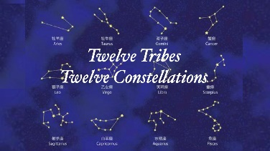
The Mazzaroth – Populating the Universe
When looking at the Mazzaroth each of the constellations represent a tribe of Israel. My theory is, that if Adam hadn't of fallen by eating from the tree, as men began to multiply on the face of the earth, and the earth reached capacity, then once we were able to make use of the rest of the planets in our solar system (maybe terraform Mars, cook hot lunch on Mercury or Venus, and store ice cream on Pluto) then the migration plan may have been for each of the 12 tribes of Israel to head out to their corresponding constellation as a Migration plan throughout the universe. If the Mazzaroth tells the story of the planet earth then maybe the other inhabitable planets out their have their story written by their own constellations. If we had the technology we might be able to look into the future and see what is to come and who is going to be where. What would be even more interesting is to find out if any planets shared a constellation story such as one of the end of the spokes of the wheel being a member of more than one planet. It could be the case where there is a few like that but most are isolated. Since we haven't been able to study every star in our galaxy we have no idea at this point whether there would be a correlation along the same line from galaxy to galaxy - there may be a story there but on a much larger scale. Keep in mind that every star has a name. I'm not talking about just Ursa Major or some other star that you read about in science but of all the millions, and billions and probably trillions of stars in the universe, they all have names. Which means they are very important. Their name may be embedded somewhere in either the structure or the layout of the universe.

