Slide 1
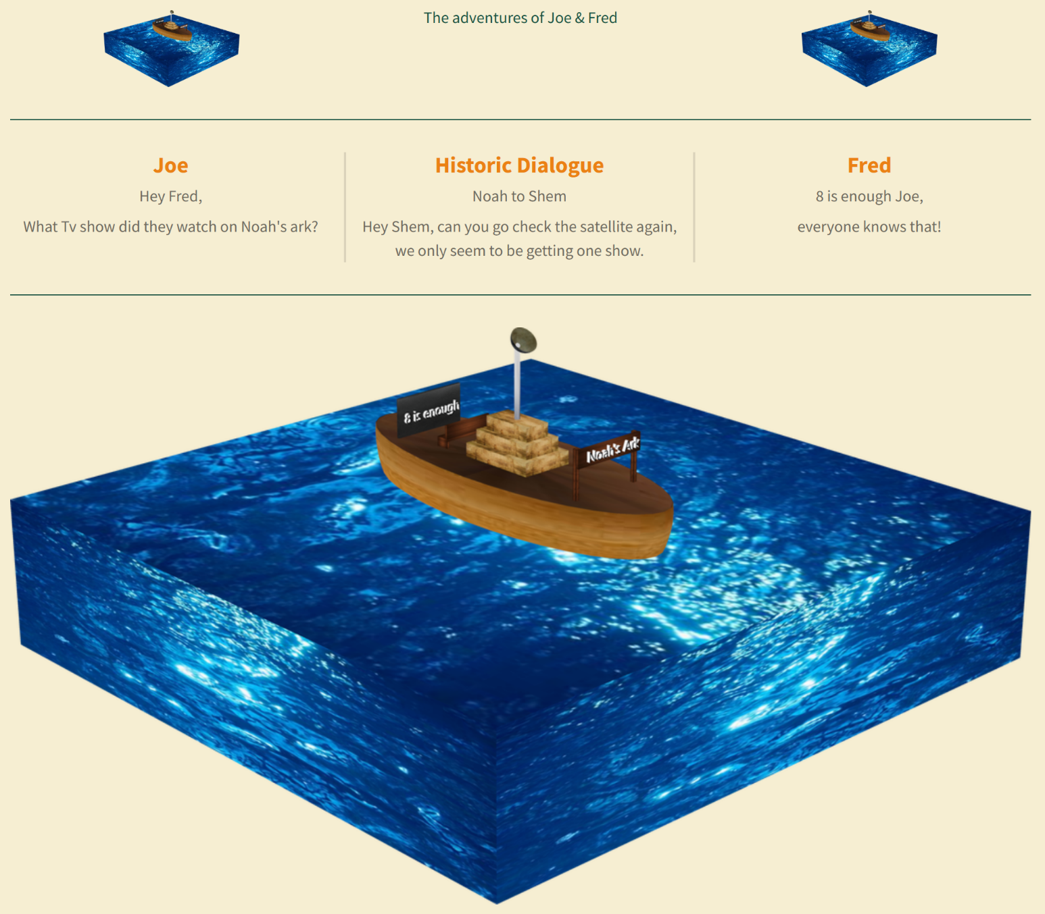
End Times & Pre Times: The Earth Lease – Part 4

Slide 2
End Times & Pre-Times: The Earth is Leased to man – for 6000 years
50 Jubilee years x 120 Genesis 6:3 years = 6000 years
Lease – a contract by which one part conveys land,
property, services, etc. to another for a specified time
^{Psalm 115:16}
^{Genesis 2:16-18}
16 The heaven, even the heavens, are the Lord's: but the earth hath he given to the children of men.
17 but of the tree of the knowledge of good and evil, thou shalt not eat of it. For in the day that thou eatest thereof, thou shalt surely die.”
^{Genesis 5:5}
5 And all the days that Adam lived were nine hundred and thirty years: and he died.
^{Genesis 6:3}
^{2 Peter 3:7-9}
3 And the Lord said, My spirit shall not always strive with man, for that he also is flesh: yet his days shall be an hundred and twenty years.
8 But, beloved, be not ignorant of this one thing: that with the Lord one day is as a thousand years, and a thousand years as one day.
^{Leviticus 25:8-10}
8 And thou shalt number seven sabbaths of years unto thee, seven times seven years; and the space of the seven sabbaths of years shall be unto thee forty and nine years.
9 Then shalt thou cause the trumpet of the jubile to sound on the tenth day of the seventh month, in the day of atonement shall ye make the trumpet sound throughout all your land.
10 And ye shall hallow the fiftieth year, and proclaim liberty throughout all the land unto all the inhabitants thereof: it shall be a jubile unto you; and ye shall return every man unto his possession, and ye shall return every man unto his family.

Slide 3
End Times & Pre-Times: Noah’s Flood vs. Lucifers Flood (Jeremiah 4)
As The judgement occurred
There were mountains that trembled
and the hills moved
The fruitful place was a wilderness
Cities were broken down
The whole land was desolate
There was no man
The birds of the heavens had fled
Prisoners had been kept unjustly
As The judgement occurred
Being married and given in marriage
Giants and fallen angels were present
Human DNA had been corrupted – 8
Thoughts of man were constantly evil
Fallen angels mixed with man
Men lived 1000 years
The earth may have had a protective canopy of water
Lucifers Flood
Total Darkness
Extreme Cold
No visible stars
Water took less than a day to abate
The earth was without form and void
No life was saved – no animals
An Ice age preceded this flood
There was no promise not to destroy the earth by water
Noah’s Flood
Night & Day were present
Regular flood based temperatures
Stars
Waters took 150 days to abate
Earth was just covered with water
8 people were saved & animals
Regular climate preceded this flood
God said never again will he destroy the earth by water

