Slide 1
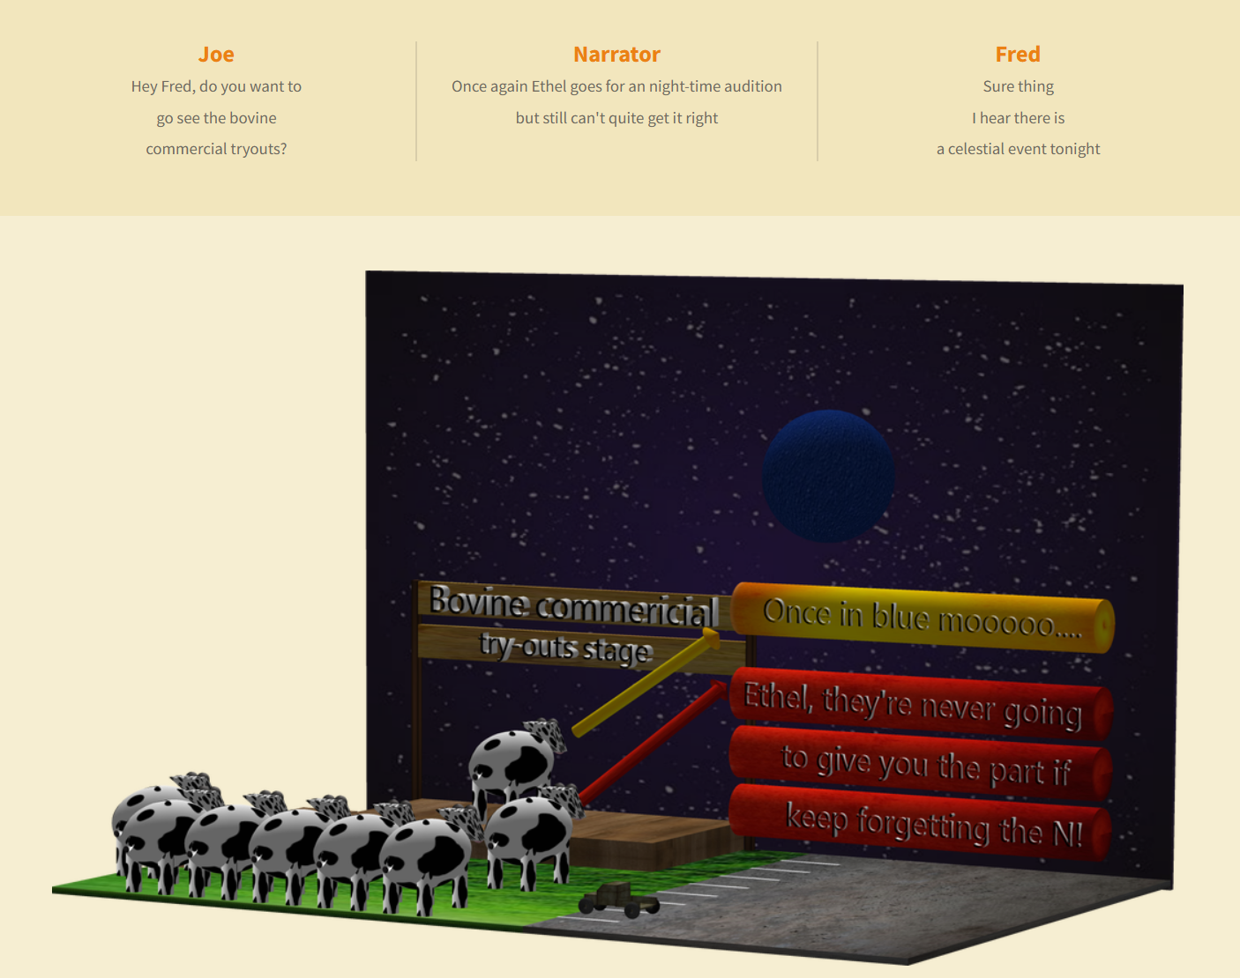
Fruits of the Spirit – Part – 1 - Humor

Slide 2
Fruits of the Spirit – Part 1
Discussion Questions
**What was the name of the bovine in the audition?
Why should you consider joy when falling into temptation?
What are the 9 fruits of the Spirit?
What kind of answer turns away wrath?
How should we live with all men?
What kind of thoughts does God think towards us?
How should be follow God?
What have children not learned how to do?
How is the peace of God described that keeps are our and minds through Jesus Christ?
Which of the fruits of the Spirit is there no law against?
Is peace related to your tongue?
What is the source of our strength?
What dries the bones?
What are the benefits of a merry heart?
How does an ambassador of God dress?
What make trait are we identified as Jesus disciples?
What did Jesus do for us and what did that show?
What scripture in Thessalonians tells us that we are partially sanctified by God?
What are the 3 parts of born-again human that are preserved blameless unto the coming of our Lord Jesus Christ?
What kind of words stir of anger?
What is the primary characteristic of Joy?

Slide 3
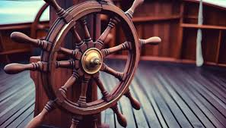
Fruits of the Spirit – Part - 1
Is peace a sign?
There are 9 fruits of Spirit that we should exhibit in our lives on a daily basis
Galatians 5:22-23
22 But the fruit of the Spirit is love, joy, peace, longsuffering, gentleness, goodness, faith,
23 Meekness, temperance: against such there is no law.
God’s peace is deeper than your worst trouble
Philippians 4:7
7 And the peace of God, which passeth all understanding, shall keep your hearts and minds through Christ Jesus.
Is peace related to your tongue?
God is a God of Peace
1 Thessalonians 5:23
23 And the very God of peace sanctify you wholly; and I pray God your whole spirit and soul and body be preserved blameless unto the coming of our Lord Jesus Christ.
Proverbs 15:1
15 A soft answer turneth away wrath: but grievous words stir up anger.
Make an Effort to live in peace
Romans 12:18
18 If it be possible, as much as lieth in you, live peaceably with all men.
God thinks thoughts of Peace toward you
Jeremiah 29:11-13
11 For I know the thoughts that I think toward you, saith the Lord, thoughts of peace, and not of evil, to give you an expected end.
12 Then shall ye call upon me, and ye shall go and pray unto me, and I will hearken unto you.
13 And ye shall seek me, and find me, when ye shall search for me with all your heart.
How should we follow God in relationship to peace?
Little children have not learned to doubt – they believe
Matthew 18:1-5
3 And said, Verily I say unto you, Except ye be converted, and become as little children, ye shall not enter into the kingdom of heaven.
Ephesians 5:1
Be ye therefore followers of God, as dear children;

Slide 4
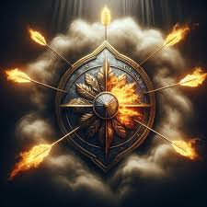
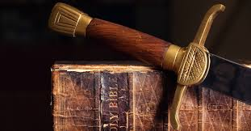
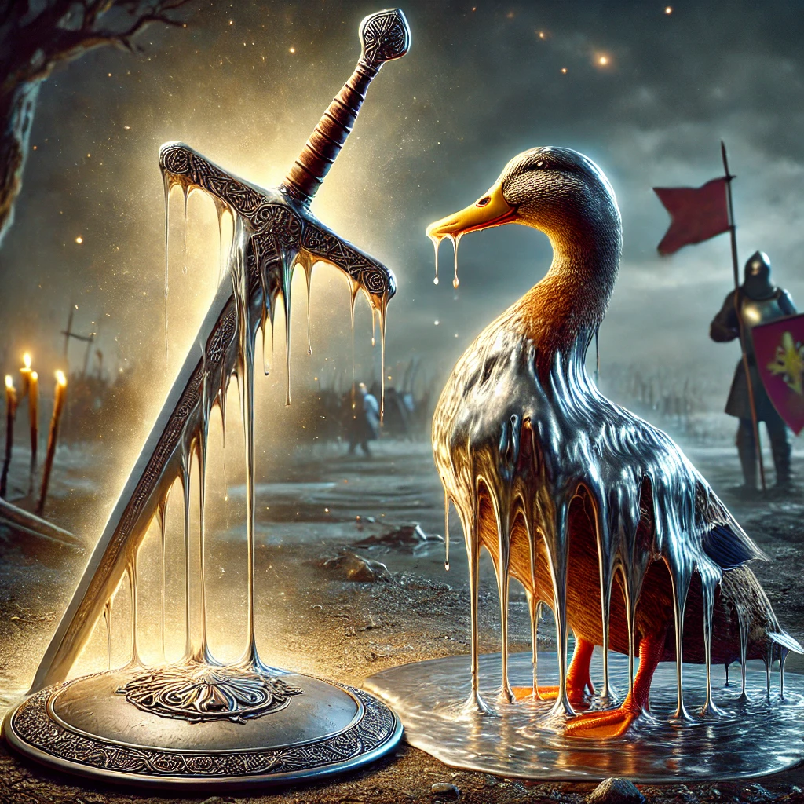
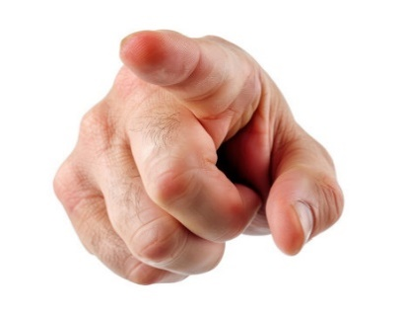
Faith Commercial – Anti-weapon coating for your shield of faith
Do you find your arm getting tired because your shield of faith is full of fiery darts?
As a result are you too tired to even pick up the sword of the spirit?
Has the enemy put “You” at the top of his hit list because you’re an easy mark?
Then do I have the deal for you!
For just 1 mustard seed of Faith
you can purchase God’s anti-weapon coating for your shield of faith. Just take an aerosol can of Isaiah 54:17 and spray thoroughly. That’s right, when the devil’s weapons hit your shield of faith they will melt just like gallium in hot water – and the residue will run off of your shield just like gallium off of a ducks back.
See what God’s anti-weapon coating system can do for you!
We now return to your regularly scheduled Bible study

Slide 5
Fruits of the Spirit – Part 1
Joy / (Patience) / Faith
Joy plays a role in receiving your victory
James 1:2-3
2 My brethren, count it all joy when ye fall into divers temptations;
3 Knowing this, that the trying of your faith worketh patience.
If the devil can’t steal your joy – he can’t steel your goods – why? Because if you are in joy during a temptation not to believe God’s promise, you will be able to exercise patience which is required for faith to work – therefore, you will receive the promise because you kept joy, and the devil talk you out of your faith.
Acts 3:8 – Joy is demonstrable
Walking, leaping and Praising God!
Nehemiah 8:10
Then he said unto them, Go your way, eat the fat, and drink the sweet, and send portions unto them for whom nothing is prepared: for this day is holy unto our Lord: neither be ye sorry; for the joy of the Lord is your strength.
Joy doesn’t even have side effects!
Proverbs 17:22
22 A merry heart doeth good like a medicine: but a broken spirit drieth the bones.

Slide 6
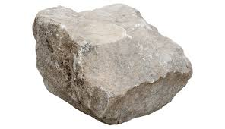
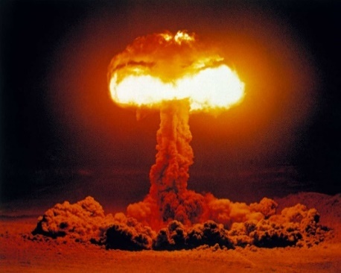
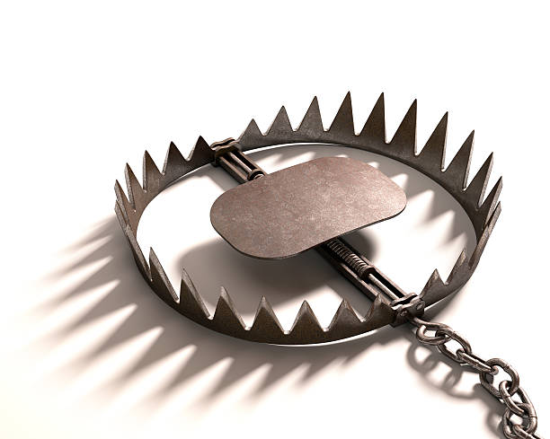
Faith Commercial - Psalm 91 Protection Services
Are you trudging through the mud of a 1000 falling at your side and 10,000 at your right hand?
Do you find yourself getting caught in bear traps made by the snare of the fowler?
Do you always find yourself dashing your foot against a stone?
Then do I have the deal for you!
For just 1 mustard seed of Faith
you can purchase God’s protections services of Psalm 91.
See what God can do for you!
We now return to your regularly scheduled Bible study

Slide 7
Fruits of the Spirit – Part 1
Showing Love – Love is an Action
Direct Acts of Kindness
Of all the good things – Love is the greater
1 Corinthians 13:13 - NAS
13 But now faith, hope, love, abide these three; but the greatest of these is love.
Some people say random acts of kindness – and although that’s better than random acts of violence, kindness takes intention – direct intention.
You are a ambassador of God – Spiritually dress like it!
Colossians 3:12-13
12 Put on therefore, as the elect of God, holy and beloved, bowels of mercies, kindness, humbleness of mind, meekness, longsuffering;
13 Forbearing one another, and forgiving one another, if any man have a quarrel against any: even as Christ forgave you, so also do ye.
Have Love on to another
John 13:35
35 By this shall all men know that ye are my disciples, if ye have love one to another.
Love see’s the heart
John 8:10-11
10 When Jesus had lifted up himself, and saw none but the woman, he said unto her, Woman, where are those thine accusers? hath no man condemned thee?
11 She said, No man, Lord. And Jesus said unto her, Neither do I condemn thee: go, and sin no more.
This means everything
1 Corinthians 16:14 - ESV
Let all that you do be done in love.
Jesus Laid down his life for us
John 15:13
13 Greater love hath no man than this, that a man lay down his life for his friends.

Slide 8
Fruits of the Spirit – Part 1
Discussion Questions
**What was the name of the bovine in the audition?
Why should you consider joy when falling into temptation?
What are the 9 fruits of the Spirit?
What kind of answer turns away wrath?
How should we live with all men?
What kind of thoughts does God think towards us?
How should be follow God?
What have children not learned how to do?
How is the peace of God described that keeps are our and minds through Jesus Christ?
Which of the fruits of the Spirit is there no law against?
Is peace related to your tongue?
What is the source of our strength?
What dries the bones?
What are the benefits of a merry heart?
How does an ambassador of God dress?
What make trait are we identified as Jesus disciples?
What did Jesus do for us and what did that show?
What scripture in Thessalonians tells us that we are partially sanctified by God?
What are the 3 parts of born-again human that are preserved blameless unto the coming of our Lord Jesus Christ?
What kind of words stir of anger?
What is the primary characteristic of Joy?

