Slide 1
End Times & Pre Times: syllabus – Part - 1
In Genesis 1 we know animals were created – it doesn’t talk about Lions – but we know Lions exist today – Genesis 1:25 - And God made the beast of the earth after his kind, and cattle after their kind, and every thing that creepeth upon the earth after his kind: and God saw that it was good. After God created the beasts of the field – we can derive that the lions (beasts) he created probably went and had lunch not long after they were created and it must have consisted of some type of leafy or grassy content. Genesis 1:30 - And to every beast of the earth, and to every fowl of the air, and to every thing that creepeth upon the earth, wherein there is life, I have given every green herb for meat: and it was so. We know this through study, analysis, and direct observation – even though the Bible does specifically say the lions had lunch. This may seem like and obvious example but keep this thought in mind as we go through this study of Pre-Times & End Times. We will always make the Word of God both the foundation and the authority while analyzing what we can learn through science and archeology and find out how they fit together. We’ll identify what we can prove through the Word of God and Science, specify which parts are conjecture (or inferential), and which parts are theories.
God has distributed Prophecy throughout his word so it cannot be removed – example: like deciding a book shouldn’t be in the bible.
Isaiah 28:10 - For precept must be upon precept, precept upon precept; line upon line, line upon line; here a little, and there a little:
God’s word is like a time release vitamin – it releases it as you need it – when you come into the time slot of which a revelation effects the church or a generation, then it becomes unveiled – even though it’s been in the Word, since its writing.
Eternity Past – Where the Father, Son, and Holy Spirit always existed as God – Probably in the 11th dimension based on String Theory
(I am not trying to put God in a “container” per say – but we have limited understanding, so we need to picture things the best we can based on what we know or have discovered along the way – we do know the Father is in heaven (which is some sort of physical spiritual location somewhere). We also know that the Bible talks about heaven being in the North. Psalm 48:2 – Beautiful for situation, the joy of the whole earth, is mount Zion, on the sides of the north, the city of the great king.
Sometimes people are deceived, sometimes they are willing ignorant
2 Peter 3:3 - Knowing this first, that there shall come in the last days scoffers, walking after their own lusts,
4 And saying, Where is the promise of his coming? for since the fathers fell asleep, all things continue as they were from the beginning of the creation.
Syllabus
https://www.mathcompiler3d.com/bible-study

Slide 2
End Times & Pre Times: syllabus – Part - 2
A composite Drawing – If you were to describe to a sketch artist what someone looks like, then they could create a likeness that when you see that person, it has enough detail that you would recognize them. God draws a composite image throughout the scriptures – and when we arrive at what he described, there is enough information present so that we recognize it.
The last Days are 3000 years long – God has been speaking to us through his son for 2000 years, and Jesus will continue to speak through the millennium
Hebrews 11:1 God, who at sundry times and in divers manners spake in time past unto the fathers by the prophets,
2 Hath in these last days spoken unto us by his Son, whom he hath appointed heir of all things, by whom also he made the worlds;
We are right at the tail end of the 6th day about to go into the 7th.
God spoke the end from the beginning – that means he said out the plan right at the start in Genesis 1 and unfolded it through the rest of scripture.
Isaiah 46:9-10
9 Remember the former things of old: for I am God, and there is none else; I am God, and there is none like me,
10 Declaring the end from the beginning, and from ancient times the things that are not yet done, saying, My counsel shall stand, and I will do all my pleasure:
Creation of the Universe – Job 38:6 – Whereupon are the foundations thereof fastened? or who laid the corner stone thereof;
7 When the morning stars sang together, and all the sons of God shouted for joy?
Paul Identifies at least 4 dimensions that we directly interact with: Ephesians 3:18: May be able to comprehend with all saints what is the breadth, and length, and depth, and height;
Lucifer has a throne on the Earth – Isaiah 14:13 - For thou hast said in thine heart, I will ascend into heaven, I will exalt my throne above the stars of God: I will sit also upon the mount of the congregation, in the sides of the north:
Lucifer mistreats those whom he has authority over – Isaiah 14:17 - That made the world as a wilderness, and destroyed the cities thereof; that opened not the house of his prisoners?
Syllabus
https://www.mathcompiler3d.com/bible-study

Slide 3
End Times & Pre Times: syllabus – Part - 3
Pyramids & Ancient Monoliths – We will investigate why there are pyramids and monoliths on most of the planet, who built them, when were they built and why. A look into crop circles and why one is particularly significant.
Carl Munck – The Ancient Monuments know where they are – and where does Mars fit in?
Lucifers Flood – When we arrive in Genesis 1:2 – the earth is already flooded
The 69 weeks of Daniel and the 70th week
The Mazzaroth – How it is different from zodiac
The Genesis 6 attempt to usurp birthright – Giants, blending of the species – both angelic and natural
The Ice Age – Job 38:29-30 - Out of whose womb came the ice? and the hoary frost of heaven, who hath gendered it?
30 The waters are hid as with a stone, and the face of the deep is frozen.
What were the stones of fire? – Lucifer walked up and down in them Ezekiel 28:14 - Thou art the anointed cherub that covereth; and I have set thee so: thou wast upon the holy mountain of God; thou hast walked up and down in the midst of the stones of fire.
What about Rahab? – Where did the asteroid belt come from
The Great Tribulation – 7 years unlike and time past or future
Does the Devil still have a chance? Yes, but no.
Where do dinosaurs come in? Behemoth, Leviathan, Argentinosaurus, and T-Rex
Dark Sentences: The Beast & The False Prophet
The Lake of Fire – The 2nd death
The millennial reign – 1000 years of peace
Loosed for a season – Satan is hot, he knows his time is short
Folded: The heavens will be folded up like a scroll
God wants only the best for his kids: New heavens and Earth will be created - unused
The new Jerusalem coming down out of heaven – Pyramid or a Cube?
The Ages to come – The exceeding riches of his grace
Who’s out there? – A short list of known beings
A message through time – Who sent it
Don’t stay in one place – a derived theory
Syllabus
https://www.mathcompiler3d.com/bible-study

Slide 4
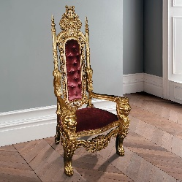
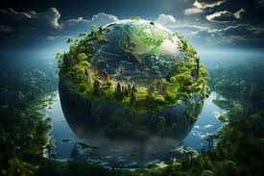
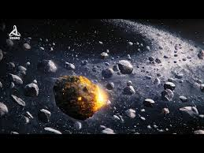
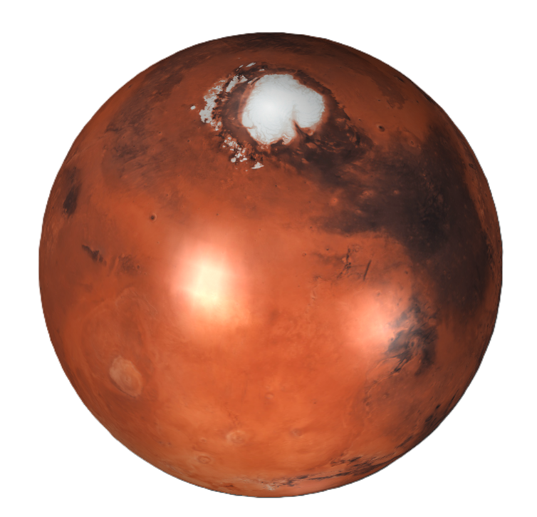
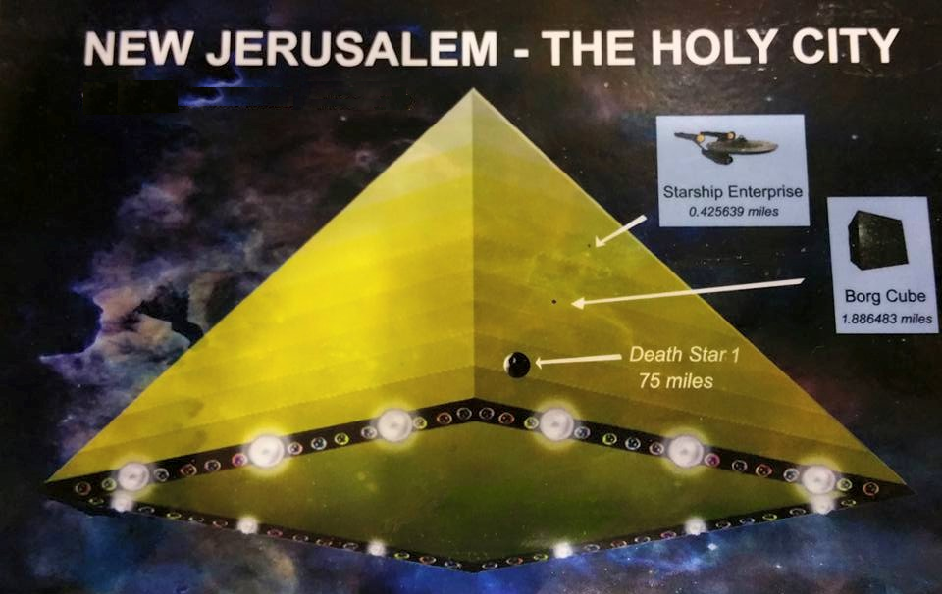
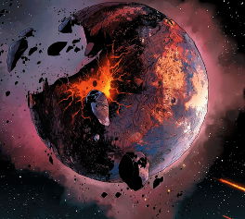
End Times & Pre-Times: An evidence-based history of time
Lucifer rules a
kingdom on earth
In the beginning God created the heaven and the earth.
He loosed not the house of his prisoners resulting in judgment
Rahab
Mars
The Ice Age on Earth
Lucifers Flood
The Make-over 6000 +/- years ago – and God said…
The World that
Was - Giants
In Genesis 1:2 – we arrive on a planet that has been totally flooded – meaning it had already existed before hand. The earth was without form and void (suggesting that a major destruction / judgment had taken place) – darkness was everywhere – illuding to the fact that there was no sun present.
End of Millenium
God Dwells with his people
Noah’s Flood
After Noah’s
Flood
New Heaven & Earth

Slide 5
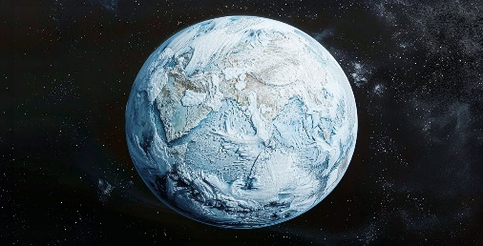
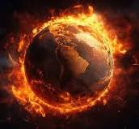
End Times & Pre Times: Introduction
Revelation 1:3
Blessed is he that readeth, and they that hear the words of this prophecy, and keep those things which are written therein: for the time is at hand.
To learn what is to come, we must learn what was
Ecclesiastes 1:9
The thing that hath been, it is that which shall be; and that which is done is that which shall be done: and there is no new thing under the sun.
The Earth Lease
Part 1
A heathenistic perspective
Some say the World will end by fire
Others say by Ice
But from what I know about Desire
I hold with those that favor fire
But if the world must perish twice
I think I’ve learn enough of hate
To say that for destruction ice is also great
And would suffice
We know through scripture that the world will perish in fire
^{2 Peter 3:10}
But the day of the Lord will come as a thief in the night; in the which the heavens shall pass away with a great noise, and the elements shall melt with fervent heat, the earth also and the works that are therein shall be burned up.
A non-heathenistic perspective
Some say the World isn’t round
But similar to flat
Their tainted views
Brought sketchy wisdom
Stating is a fact
But I for one will sail the sea
Whether edge be there or not
And bold with faith
I shall find
Those things which must be sought
We know we are in the last days of the end times – and time is very short. Although we don’t know the day and the hour of the return of Jesus, we might be able to know the season.
https://www.mathcompiler3d.com/bible-study

Slide 6
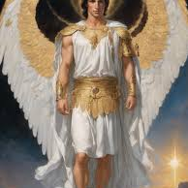
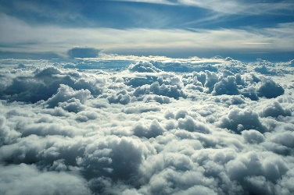
End Times & Pre-Times: The correct order to read the bible
In the beginning was the Word – Jesus said, before Abraham was, I am!
All things were created by Jesus the Word
The Earth has foundations
The Earth has a corner stone
John 1:1
1 In the beginning was the Word, and the Word was with God, and the Word was God.
2 The same was in the beginning with God.
3 All things were made by him; and without him was not any thing made that was made.
Job 38:4-7
4 Where wast thou when I laid the foundations of the earth? declare, if thou hast understanding.
5 Who hath laid the measures thereof, if thou knowest? or who hath stretched the line upon it?
6 Whereupon are the foundations thereof fastened? or who laid the corner stone thereof;
7 When the morning stars sang together, and all the sons of God shouted for joy?
Lucifer was created being – an Arc Angel
Lucifer wanted to ascend above the heights of the clouds
He had a throne on Earth
He made the World a wilderness
He destroyed cities
He kept prisoners
Job 38:4-7
12 How art thou fallen from heaven, O Lucifer, son of the morning! how art thou cut down to the ground, which didst weaken the nations!
13 For thou hast said in thine heart, I will ascend into heaven, I will exalt my throne above the stars of God: I will sit also upon the mount of the congregation, in the sides of the north:
14 I will ascend above the heights of the clouds; I will be like the most High.
15 Yet thou shalt be brought down to hell, to the sides of the pit.
16 They that see thee shall narrowly look upon thee, and consider thee, saying, Is this the man that made the earth to tremble, that did shake kingdoms;
17 That made the world as a wilderness, and destroyed the cities thereof; that opened not the house of his prisoners?
Ezekiel 28:12-13
12 Son of man, take up a lamentation upon the king of Tyrus, and say unto him, Thus saith the Lord God; Thou sealest up the sum, full of wisdom, and perfect in beauty.
13 Thou hast been in Eden the garden of God; every precious stone was thy covering, the sardius, topaz, and the diamond, the beryl, the onyx, and the jasper, the sapphire, the emerald, and the carbuncle, and gold: the workmanship of thy tabrets and of thy pipes was prepared in thee in the day that thou wast created.
Genesis 1:1
1 In the beginning God created the heaven and the earth.

Slide 7
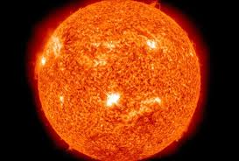
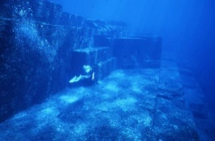
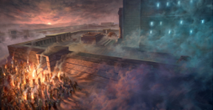
End Times & Pre-Times: The correct order to read the bible
Jeremiah 4:23 – An enhanced description of Genesis 1:2
This is the description of Gods judgment of the creation that Lucifer messes up
No light –not even in the heavens (Ex. Stars) the unnatural darkness of God’s judgment that required God to say later, let there be light.
Verse 25: There was man in the first creation – of what type – we don’t know
All the birds fled
Verse 26: The first creation was a fruitful place, and became a wilderness
There were cities in the first creation
The Lord made the whole land desolate – but he didn’t make a full end
Verse 28: God made the heaven black – another reference to the unnatural darkness in Genesis 1:2
Eden the garden of God, is different then the garden of Eden
Jeremiah 4:23-28
23 I beheld the earth, and, lo, it was without form, and void; and the heavens, and they had no light.
24 I beheld the mountains, and, lo, they trembled, and all the hills moved lightly.
25 I beheld, and, lo, there was no man, and all the birds of the heavens were fled.
26 I beheld, and, lo, the fruitful place was a wilderness, and all the cities thereof were broken down at the presence of the Lord, and by his fierce anger.
27 For thus hath the Lord said, The whole land shall be desolate; yet will I not make a full end.
28 For this shall the earth mourn, and the heavens above be black; because I have spoken it, I have purposed it, and will not repent, neither will I turn back from it.
Lucifer was in Eden, the Garden of God
Lucifer was “made” with precious stones
Lucifer was also made of tabrets and pipes – there may be been music as he walked
He walked up and down in the midst of the stones of fire
Lucifer was an anointed Cherub
Lucifer was perfect until iniquity was found in him
He was filled with violence
He had maximum beauty and brightness
He defiled sanctuaries
He committed a multitude of iniquities – he did some kind of trafficking
Ezekiel 28:14-19
14 Thou art the anointed cherub that covereth; and I have set thee so: thou wast upon the holy mountain of God; thou hast walked up and down in the midst of the stones of fire.
15 Thou wast perfect in thy ways from the day that thou wast created, till iniquity was found in thee.
16 By the multitude of thy merchandise they have filled the midst of thee with violence, and thou hast sinned: therefore I will cast thee as profane out of the mountain of God: and I will destroy thee, O covering cherub, from the midst of the stones of fire.
17 Thine heart was lifted up because of thy beauty, thou hast corrupted thy wisdom by reason of thy brightness: I will cast thee to the ground, I will lay thee before kings, that they may behold thee.
18 Thou hast defiled thy sanctuaries by the multitude of thine iniquities, by the iniquity of thy traffick; therefore will I bring forth a fire from the midst of thee, it shall devour thee, and I will bring thee to ashes upon the earth in the sight of all them that behold thee.
19 All they that know thee among the people shall be astonished at thee: thou shalt be a terror, and never shalt thou be any more.

Slide 8
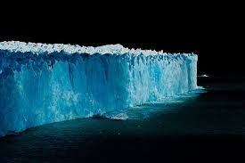
End Times & Pre-Times: The correct order to read the bible
The Ice Age
Job 38:29
29 Out of whose womb came the ice? and the hoary frost of heaven, who hath gendered it?
Ice age and Lucifer’s flood
Job 38:8
8 Or who shut up the sea with doors, when it brake forth, as if it had issued out of the womb?
The unnatural darkness via the judgment of God from Genesis 1:2 – this is the reason God said, let there be light!
Job 38:9
9 When I made the cloud the garment thereof, and thick darkness a swaddlingband for it,
End of the Ice Age / Lucifer’s flood / and a mass destruction – note the “without form” portion
Genesis 1:2
2 And the earth was without form, and void; and darkness was upon the face of the deep. And the Spirit of God moved upon the face of the waters.

Slide 9
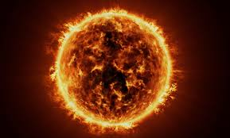
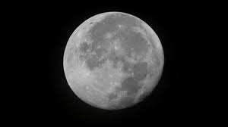
End Times & Pre-Times: Let there be light!
We start with the Make-Over of the earth, about 6000 years ago
Genesis 1:3
The light wasn’t the sun
3 And God said, Let there be light: and there was light.
The greater light wasn’t created until verse 16
Genesis 1:16
16 And God made two great lights; the greater light to rule the day, and the lesser light to rule the night: he made the stars also.

