Slide 1
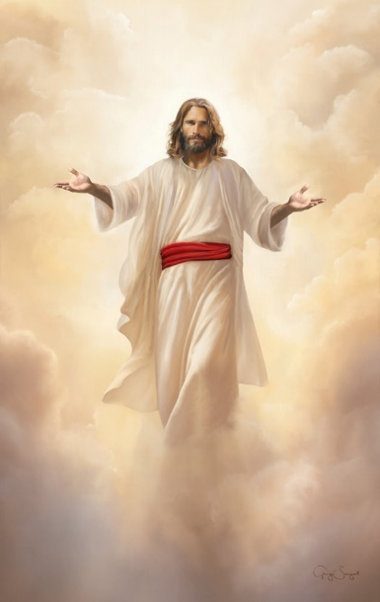
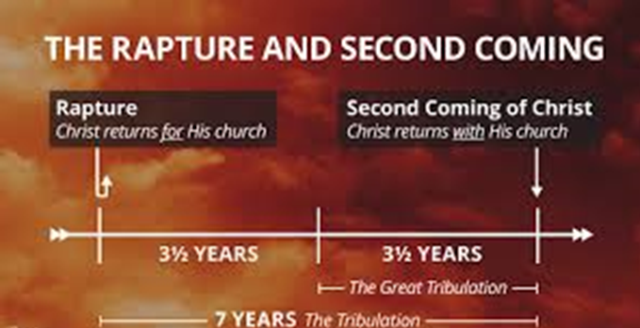
End Times & Pre-Times: Part - 3
The rapture / Tribulation
The rapture of the Church is not the second advent – in the rapture, Jesus appears in the clouds
Acts 1:11
11 Which also said, Ye men of Galilee, why stand ye gazing up into heaven? this same Jesus, which is taken up from you into heaven, shall so come in like manner as ye have seen him go into heaven.
1 Corinthians 15:51-52
51 Behold, I shew you a mystery; We shall not all sleep, but we shall all be changed,
52 In a moment, in the twinkling of an eye, at the last trump: for the trumpet shall sound, and the dead shall be raised incorruptible, and we shall be changed.
The Earth Lease
Part 3
Matthew 24:21-22
21 For then shall be great tribulation, such as was not since the beginning of the world to this time, no, nor ever shall be.
22 And except those days should be shortened, there should no flesh be saved: but for the elect's sake those days shall be shortened.
https://www.mathcompiler3d.com/bible-study

Slide 2
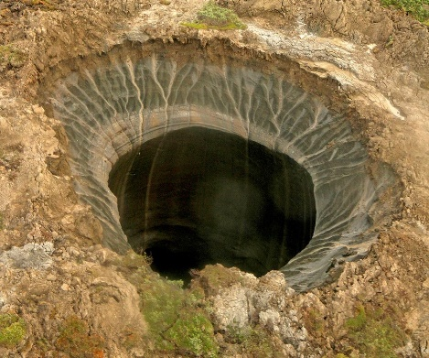
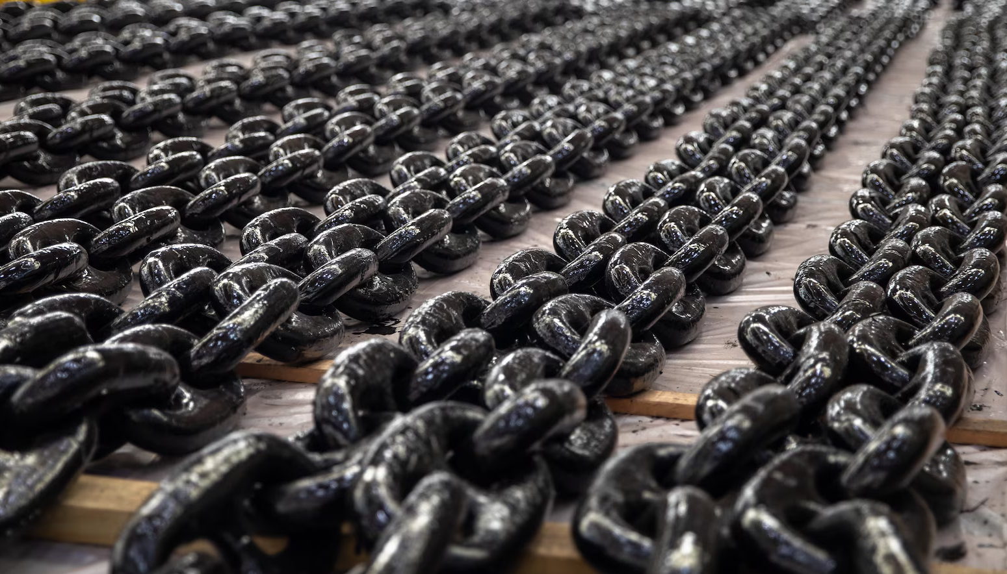
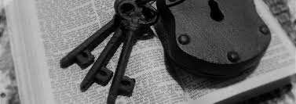
End Times & Pre-Times: Part - 3
The Key of the bottomless pit
Revelation 20:1-6
20 And I saw an angel come down from heaven, having the key of the bottomless pit and a great chain in his hand.
2 And he laid hold on the dragon, that old serpent, which is the Devil, and Satan, and bound him a thousand years,
3 And cast him into the bottomless pit, and shut him up, and set a seal upon him, that he should deceive the nations no more, till the thousand years should be fulfilled: and after that he must be loosed a little season.
4 And I saw thrones, and they sat upon them, and judgment was given unto them: and I saw the souls of them that were beheaded for the witness of Jesus, and for the word of God, and which had not worshipped the beast, neither his image, neither had received his mark upon their foreheads, or in their hands; and they lived and reigned with Christ a thousand years.
5 But the rest of the dead lived not again until the thousand years were finished. This is the first resurrection.
6 Blessed and holy is he that hath part in the first resurrection: on such the second death hath no power, but they shall be priests of God and of Christ, and shall reign with him a thousand years.

Slide 3
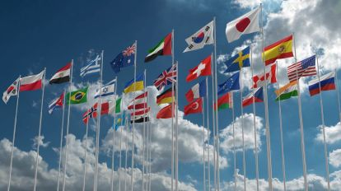
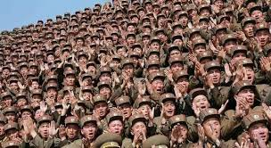
End Times & Pre-Times: Part - 3
And when the thousand years are expired
Satan is loosed for a season after the 1000 years
Revelation 20:7-8
⁷ And when the thousand years are expired, Satan shall be loosed out of his prison,
⁸ And shall go out to deceive the nations which are in the four quarters of the earth, Gog, and Magog, to gather them together to battle: the number of whom is as the sand of the sea.
What kind of weapons do they think will defeat God?

Slide 4
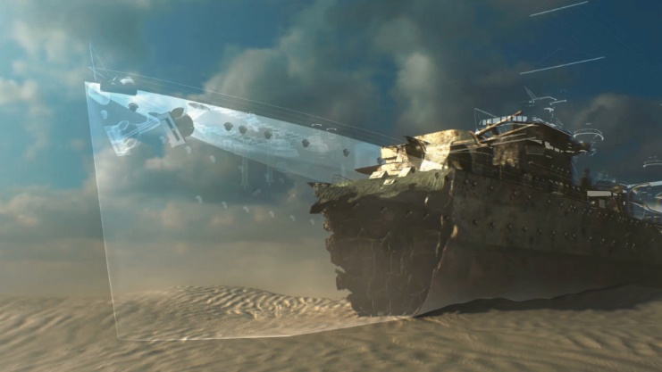
End Times & Pre-Times: Part - 3
That great city, the holy Jerusalem,
descending out of heaven from God
There was no more sea
God wipes away all tears
There is no more pain, death, sorrow, or crying
Behold God makes all things new
There are 12 gates on the New Jerusalem
The walls had 12 foundations with the names of the Apostles
Revelation 21:1-5
21 And I saw a new heaven and a new earth: for the first heaven and the first earth were passed away; and there was no more sea.
² And I John saw the holy city, new Jerusalem, coming down from God out of heaven, prepared as a bride adorned for her husband.
³ And I heard a great voice out of heaven saying, Behold, the tabernacle of God is with men, and he will dwell with them, and they shall be his people, and God himself shall be with them, and be their God.
⁴ And God shall wipe away all tears from their eyes; and there shall be no more death, neither sorrow, nor crying, neither shall there be any more pain: for the former things are passed away.
⁵ And he that sat upon the throne said, Behold, I make all things new. And he said unto me, Write: for these words are true and faithful.

Slide 5
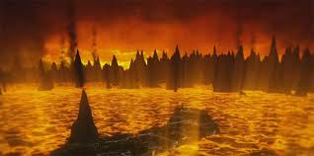
End Times & Pre-Times: Part - 3
That great city, the holy Jerusalem,
descending out of heaven from God
Revelation 21:6-10
⁶ And he said unto me, It is done. I am Alpha and Omega, the beginning and the end. I will give unto him that is athirst of the fountain of the water of life freely.
⁷ He that overcometh shall inherit all things; and I will be his God, and he shall be my son.
⁸ But the fearful, and unbelieving, and the abominable, and murderers, and whoremongers, and sorcerers, and idolaters, and all liars, shall have their part in the lake which burneth with fire and brimstone: which is the second death.
⁹ And there came unto me one of the seven angels which had the seven vials full of the seven last plagues, and talked with me, saying, Come hither, I will shew thee the bride, the Lamb's wife.
¹⁰ And he carried me away in the spirit to a great and high mountain, and shewed me that great city, the holy Jerusalem, descending out of heaven from God,

Slide 6
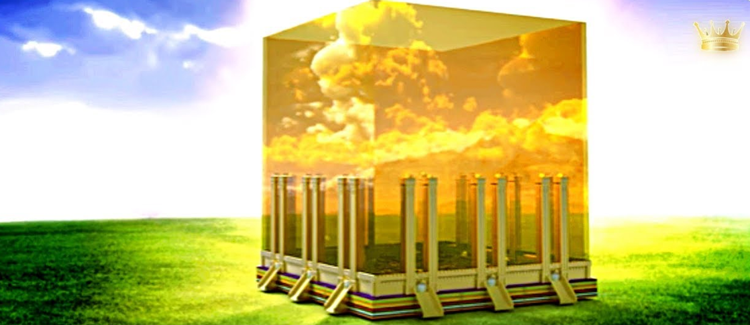
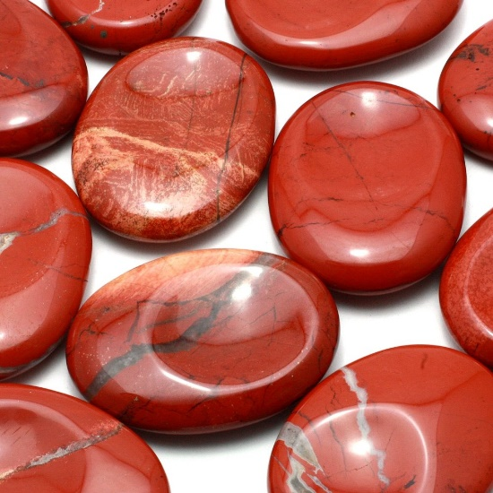
End Times & Pre-Times: Part - 3
The names of the 12 tribes of Israel on the gates
Revelation 21:11-15
¹¹ Having the glory of God: and her light was like unto a stone most precious, even like a jasper stone, clear as crystal;
¹² And had a wall great and high, and had twelve gates, and at the gates twelve angels, and names written thereon, which are the names of the twelve tribes of the children of Israel:
¹³ On the east three gates; on the north three gates; on the south three gates; and on the west three gates.
¹⁴ And the wall of the city had twelve foundations, and in them the names of the twelve apostles of the Lamb.
¹⁵ And he that talked with me had a golden reed to measure the city, and the gates thereof, and the wall thereof.

Slide 7
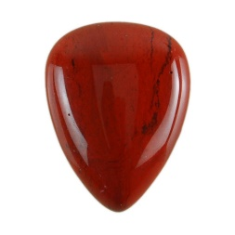
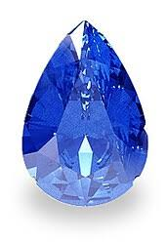
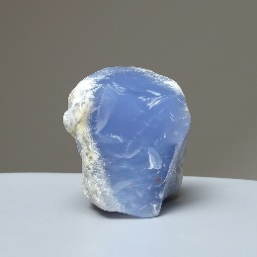
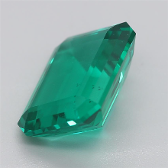
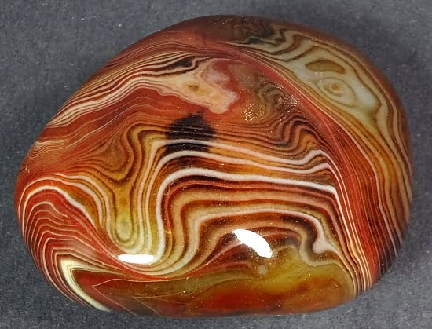
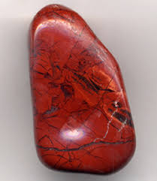
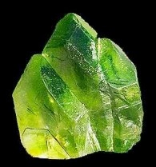
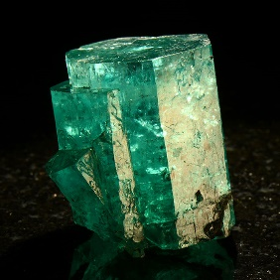
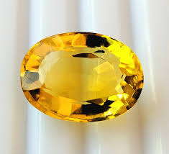
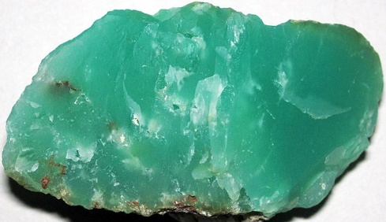
End Times & Pre-Times: Part - 3
The city was pure gold
Revelation 21:16-20
¹⁶ And the city lieth foursquare, and the length is as large as the breadth: and he measured the city with the reed, twelve thousand furlongs. The length and the breadth and the height of it are equal.
¹⁷ And he measured the wall thereof, an hundred and forty and four cubits, according to the measure of a man, that is, of the angel.
¹⁸ And the building of the wall of it was of jasper: and the city was pure gold, like unto clear glass.
¹⁹ And the foundations of the wall of the city were garnished with all manner of precious stones. The first foundation was jasper; the second, sapphire; the third, a chalcedony; the fourth, an emerald;
²⁰ The fifth, sardonyx; the sixth, sardius; the seventh, chrysolyte; the eighth, beryl; the ninth, a topaz; the tenth, a chrysoprasus; the eleventh, a jacinth; the twelfth, an amethyst.

Slide 8
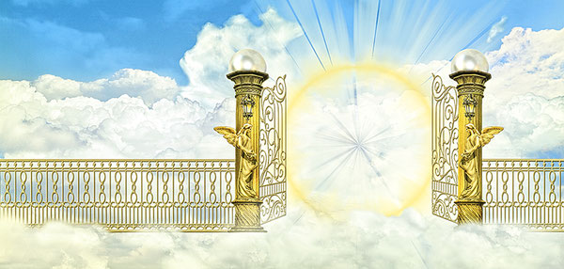
End Times & Pre-Times: Part - 3
12 Gates made of pearls
Revelation 21:21-27
²¹ And the twelve gates were twelve pearls: every several gate was of one pearl: and the street of the city was pure gold, as it were transparent glass.
²² And I saw no temple therein: for the Lord God Almighty and the Lamb are the temple of it.
²³ And the city had no need of the sun, neither of the moon, to shine in it: for the glory of God did lighten it, and the Lamb is the light thereof.
²⁴ And the nations of them which are saved shall walk in the light of it: and the kings of the earth do bring their glory and honour into it.
²⁵ And the gates of it shall not be shut at all by day: for there shall be no night there.
²⁶ And they shall bring the glory and honour of the nations into it.
²⁷ And there shall in no wise enter into it any thing that defileth, neither whatsoever worketh abomination, or maketh a lie: but they which are written in the Lamb's book of life.

Slide 9
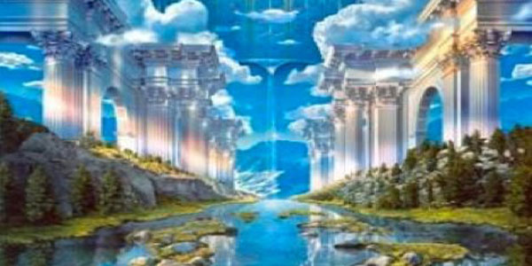
End Times & Pre-Times: Part - 3
A river of the water of life flows out of the throne of God
Revelation 22:1-5
22 And he shewed me a pure river of water of life, clear as crystal, proceeding out of the throne of God and of the Lamb.
² In the midst of the street of it, and on either side of the river, was there the tree of life, which bare twelve manner of fruits, and yielded her fruit every month: and the leaves of the tree were for the healing of the nations.
³ And there shall be no more curse: but the throne of God and of the Lamb shall be in it; and his servants shall serve him:
⁴ And they shall see his face; and his name shall be in their foreheads.
⁵ And there shall be no night there; and they need no candle, neither light of the sun; for the Lord God giveth them light: and they shall reign for ever and ever.

Slide 10
End Times & Pre-Times: Part - 3
For the time is at hand
Revelation 22:6-10
⁶ And he said unto me, These sayings are faithful and true: and the Lord God of the holy prophets sent his angel to shew unto his servants the things which must shortly be done.
⁷ Behold, I come quickly: blessed is he that keepeth the sayings of the prophecy of this book.
⁸ And I John saw these things, and heard them. And when I had heard and seen, I fell down to worship before the feet of the angel which shewed me these things.
⁹ Then saith he unto me, See thou do it not: for I am thy fellowservant, and of thy brethren the prophets, and of them which keep the sayings of this book: worship God.
¹⁰ And he saith unto me, Seal not the sayings of the prophecy of this book: for the time is at hand.

Slide 11
End Times & Pre-Times: Part - 3
Behold, I come quickly
Revelation 22:11-15
¹¹ He that is unjust, let him be unjust still: and he which is filthy, let him be filthy still: and he that is righteous, let him be righteous still: and he that is holy, let him be holy still.
¹² And, behold, I come quickly; and my reward is with me, to give every man according as his work shall be.
¹³ I am Alpha and Omega, the beginning and the end, the first and the last.
¹⁴ Blessed are they that do his commandments, that they may have right to the tree of life, and may enter in through the gates into the city.
¹⁵ For without are dogs, and sorcerers, and whoremongers, and murderers, and idolaters, and whosoever loveth and maketh a lie.

Slide 12
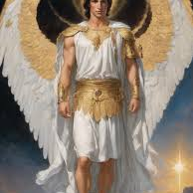
End Times & Pre-Times: Part - 3
I Jesus have sent mine angel to testify
Revelation 22:16-21
¹⁶ I Jesus have sent mine angel to testify unto you these things in the churches. I am the root and the offspring of David, and the bright and morning star.
¹⁷ And the Spirit and the bride say, Come. And let him that heareth say, Come. And let him that is athirst come. And whosoever will, let him take the water of life freely.
¹⁸ For I testify unto every man that heareth the words of the prophecy of this book, If any man shall add unto these things, God shall add unto him the plagues that are written in this book:
¹⁹ And if any man shall take away from the words of the book of this prophecy, God shall take away his part out of the book of life, and out of the holy city, and from the things which are written in this book.
²⁰ He which testifieth these things saith, Surely I come quickly. Amen. Even so, come, Lord Jesus.
²¹ The grace of our Lord Jesus Christ be with you all. Amen.

Slide 13
End Times & Pre-Times: Part - 3
The exceeding riches of his grace
Ephesians 2:7-9
⁷ That in the ages to come he might shew the exceeding riches of his grace in his kindness toward us through Christ Jesus.
⁸ For by grace are ye saved through faith; and that not of yourselves: it is the gift of God:
⁹ Not of works, lest any man should boast.

