Slide 1
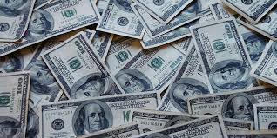
What does God’s Word say about money?
In the old testament
God required tithe (23.5 %)
Money
Part #1
I used to think that if you tithed this scripture said their would be meat in your house, but when you read it, it actually says in God’s house.
God’s gives more than just a promise – he says prove me, and signs his name, that he will open the windows of heaven and pour you out a blessing that there isn’t room enough to receive.
Malachi 3:10
10 Bring ye all the tithes into the storehouse, that there may be meat in mine house, and prove me now herewith, saith the Lord of hosts, if I will not open you the windows of heaven, and pour you out a blessing, that there shall not be room enough to receive it.
https://www.mathcompiler3d.com/bible-study

Slide 2
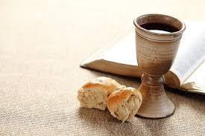
Abraham tithes to Melchizedek
The priest of the most-high God
Genesis 14:14-20
¹⁴ And when Abram heard that his brother was taken captive, he armed his trained servants, born in his own house, three hundred and eighteen, and pursued them unto Dan.
¹⁵ And he divided himself against them, he and his servants, by night, and smote them, and pursued them unto Hobah, which is on the left hand of Damascus.
¹⁶ And he brought back all the goods, and also brought again his brother Lot, and his goods, and the women also, and the people.
¹⁷ And the king of Sodom went out to meet him after his return from the slaughter of Chedorlaomer, and of the kings that were with him, at the valley of Shaveh, which is the king's dale.
¹⁸ And Melchizedek king of Salem brought forth bread and wine: and he was the priest of the most high God.
¹⁹ And he blessed him, and said, Blessed be Abram of the most high God, possessor of heaven and earth:
²⁰ And blessed be the most high God, which hath delivered thine enemies into thy hand. And he gave him tithes of all.

Slide 3
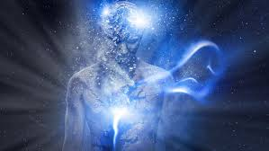
Prosperity: Not just Money
What does it mean to have your soul prosper
Your soul is your mind, will, and emotions.
Mind – the more you know, the more you can do – this is in all 5 of the areas: Spiritual, Physical, Financial, Emotional, and mental
Will – Self-control is will-power, but also a fruit of the Spirit
Emotions – Be angry and sin not!
3 John 2
² Beloved, I wish above all things that thou mayest prosper and be in health, even as thy soul prospereth.

Slide 4
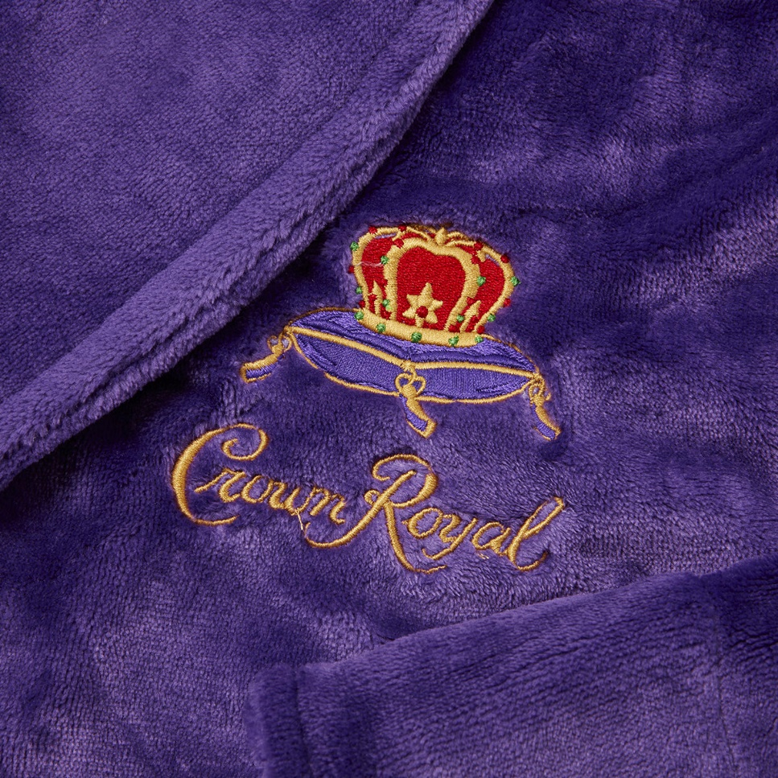
Did Jesus have more than enough?
They gambled over the clothes of Jesus
They must have been Zegna, Canali, Brioni, Kiton, Tom Ford, Gucci, Dolce & Gabbana or Giorgio Armasni
John 19:23-24
²³ Then the soldiers, when they had crucified Jesus, took his garments, and made four parts, to every soldier a part; and also his coat: now the coat was without seam, woven from the top throughout.
²⁴ They said therefore among themselves, Let us not rend it, but cast lots for it, whose it shall be: that the scripture might be fulfilled, which saith, They parted my raiment among them, and for my vesture they did cast lots. These things therefore the soldiers did.

Slide 5
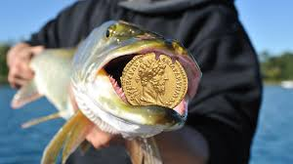
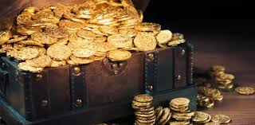
More than enough?
More than enough - can also refer to the spiritual knowledge to obtain what is needed
Remember when he said the girl is just asleep?
Jesus had a habit of speaking faith in his day to day life.
When money was needed for taxes Jesus said – go fishing
He tapped into a spiritual level based on what must have been Mark 11:23
Matthew 17:27
²⁷ Notwithstanding, lest we should offend them, go thou to the sea, and cast an hook, and take up the fish that first cometh up; and when thou hast opened his mouth, thou shalt find a piece of money: that take, and give unto them for me and thee.
Tax

Slide 6
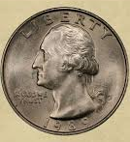
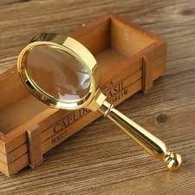
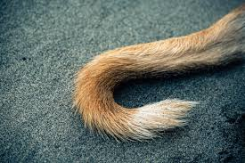
A Quarter that always lands on Heads!
Above and Not beneath!
To Observe and to do
Question: is this scripture something you confess daily?
Deuteronomy 28:13
13 And the Lord shall make thee the head, and not the tail; and thou shalt be above only, and thou shalt not be beneath; if that thou hearken unto the commandments of the Lord thy God, which I command thee this day, to observe and to do them:
Confession: The Lord makes me the head and not the tail; I am above only and not beneath. I hearken diligently to the commands of the Lord. I observe then and do them.

Slide 7
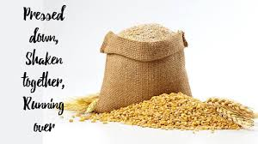
Pressed down, shaken together, and running over!
Pressed down, shaken together, and running over.
This means as much as you can carry in your basket – no space left unfilled.
Luke 6:38
³⁸ Give, and it shall be given unto you; good measure, pressed down, and shaken together, and running over, shall men give into your bosom. For with the same measure that ye mete withal it shall be measured to you again.

Slide 8
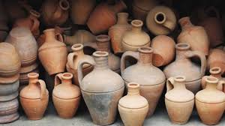
Not another vessel more
Give to God first and he will pour out a huge blessing
There is not another vessel more

Slide 9
One pot of oil
What can God do with what you have?
2 Kings 4:1-5
Now there cried a certain woman of the wives of the sons of the prophets unto Elisha, saying, Thy servant my husband is dead; and thou knowest that thy servant did fear the Lord: and the creditor is come to take unto him my two sons to be bondmen.
2 And Elisha said unto her, What shall I do for thee? tell me, what hast thou in the house? And she said, Thine handmaid hath not any thing in the house, save a pot of oil.
3 Then he said, Go, borrow thee vessels abroad of all thy neighbours, even empty vessels; borrow not a few.
4 And when thou art come in, thou shalt shut the door upon thee and upon thy sons, and shalt pour out into all those vessels, and thou shalt set aside that which is full.
5 So she went from him, and shut the door upon her and upon her sons, who brought the vessels to her; and she poured out.

Slide 10
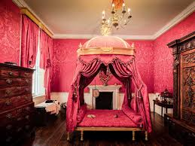
Pay your debts and live on the rest
2 Kings 4:6 - 10
Pay your debts and live on the rest
Also let’s make a place so the prophet has a place to recharge – do you have a spare room?
6 And it came to pass, when the vessels were full, that she said unto her son, Bring me yet a vessel. And he said unto her, There is not a vessel more. And the oil stayed.
7 Then she came and told the man of God. And he said, Go, sell the oil, and pay thy debt, and live thou and thy children of the rest.
8 And it fell on a day, that Elisha passed to Shunem, where was a great woman; and she constrained him to eat bread. And so it was, that as oft as he passed by, he turned in thither to eat bread.
9 And she said unto her husband, Behold now, I perceive that this is an holy man of God, which passeth by us continually.
10 Let us make a little chamber, I pray thee, on the wall; and let us set for him there a bed, and a table, and a stool, and a candlestick: and it shall be, when he cometh to us, that he shall turn in thither.

Slide 11
A desire for Offspring
2 Kings 4:11 - 15
11 And it fell on a day, that he came thither, and he turned into the chamber, and lay there.
12 And he said to Gehazi his servant, Call this Shunammite. And when he had called her, she stood before him.
13 And he said unto him, Say now unto her, Behold, thou hast been careful for us with all this care; what is to be done for thee? wouldest thou be spoken for to the king, or to the captain of the host? And she answered, I dwell among mine own people.
14 And he said, What then is to be done for her? And Gehazi answered, Verily she hath no child, and her husband is old.
15 And he said, Call her. And when he had called her, she stood in the door.

Slide 12
My head, my head!
2 Kings 4:16 - 20
A lot of time passed in this section
16 And he said, About this season, according to the time of life, thou shalt embrace a son. And she said, Nay, my lord, thou man of God, do not lie unto thine handmaid.
17 And the woman conceived, and bare a son at that season that Elisha had said unto her, according to the time of life.
18 And when the child was grown, it fell on a day, that he went out to his father to the reapers.
19 And he said unto his father, My head, my head. And he said to a lad, Carry him to his mother.
20 And when he had taken him, and brought him to his mother, he sat on her knees till noon, and then died.

Slide 13
Its not the new moon or the sabbath…
2 Kings 4:21 - 25
Its not the new moon or the sabbath – what do you need the man of God for?
21 And she went up, and laid him on the bed of the man of God, and shut the door upon him, and went out.
22 And she called unto her husband, and said, Send me, I pray thee, one of the young men, and one of the asses, that I may run to the man of God, and come again.
23 And he said, Wherefore wilt thou go to him to day? it is neither new moon, nor sabbath. And she said, It shall be well.
24 Then she saddled an ass, and said to her servant, Drive, and go forward; slack not thy riding for me, except I bid thee.
25 So she went and came unto the man of God to mount Carmel. And it came to pass, when the man of God saw her afar off, that he said to Gehazi his servant, Behold, yonder is that Shunammite:

Slide 14
All is Well!
2 Kings 4:21 - 25
She continues to speak in faith – All is [still] well!
26 Run now, I pray thee, to meet her, and say unto her, Is it well with thee? is it well with thy husband? is it well with the child? And she answered, It is well:
27 And when she came to the man of God to the hill, she caught him by the feet: but Gehazi came near to thrust her away. And the man of God said, Let her alone; for her soul is vexed within her: and the Lord hath hid it from me, and hath not told me.
28 Then she said, Did I desire a son of my lord? did I not say, Do not deceive me?
29 Then he said to Gehazi, Gird up thy loins, and take my staff in thine hand, and go thy way: if thou meet any man, salute him not; and if any salute thee, answer him not again: and lay my staff upon the face of the child.
30 And the mother of the child said, As the Lord liveth, and as thy soul liveth, I will not leave thee. And he arose, and followed her.

Slide 15
Seven sneezes and the eyes are no longer closed
2 Kings 4:21 - 25
Look at the result of honoring a prophet of God – her son is raised from the dead
31 And Gehazi passed on before them, and laid the staff upon the face of the child; but there was neither voice, nor hearing. Wherefore he went again to meet him, and told him, saying, The child is not awaked.
32 And when Elisha was come into the house, behold, the child was dead, and laid upon his bed.
33 He went in therefore, and shut the door upon them twain, and prayed unto the Lord.
34 And he went up, and lay upon the child, and put his mouth upon his mouth, and his eyes upon his eyes, and his hands upon his hands: and stretched himself upon the child; and the flesh of the child waxed warm.
35 Then he returned, and walked in the house to and fro; and went up, and stretched himself upon him: and the child sneezed seven times, and the child opened his eyes.
36 And he called Gehazi, and said, Call this Shunammite. So he called her. And when she was come in unto him, he said, Take up thy son.
37 Then she went in, and fell at his feet, and bowed herself to the ground, and took up her son, and went out.

Slide 16
How Jesus perceives giving
Its not how amount, but it’s the portion of what you have
When you have little, everything you have is a lot!
Mark 12:41-44
⁴¹ And Jesus sat over against the treasury, and beheld how the people cast money into the treasury: and many that were rich cast in much.
⁴² And there came a certain poor widow, and she threw in two mites, which make a farthing.
⁴³ And he called unto him his disciples, and saith unto them, Verily I say unto you, That this poor widow hath cast more in, than all they which have cast into the treasury:
⁴⁴ For all they did cast in of their abundance; but she of her want did cast in all that she had, even all her living.
Matthew 6:21
²¹ For where your treasure is, there will your heart be also.

Slide 17
Double, Double & 0
God expects you to invest what you have
Matthew 25:14-19
14 For the kingdom of heaven is as a man travelling into a far country, who called his own servants, and delivered unto them his goods.
15 And unto one he gave five talents (,,,,), to another two (,,), and to another one (); to every man according to his several ability; and straightway took his journey.
16 Then he that had received the five talents went and traded with the same, and made them other five talents.
17 And likewise he that had received two, he also gained other two.
18 But he that had received one went and digged in the earth, and hid his lord's money.
19 After a long time the lord of those servants cometh, and reckoneth with them.

Slide 18
Not good news
Wicked and slothful
He lost that which he was given
Notice that the extra bag wasn’t given to the one who produced 2 new talents
²⁶ His lord answered and said unto him, Thou wicked and slothful servant, thou knewest that I reap where I sowed not, and gather where I have not strawed:
²⁷ Thou oughtest therefore to have put my money to the exchangers, and then at my coming I should have received mine own with usury.
²⁸ Take therefore the talent from him, and give it unto him which hath ten talents.
²⁹ For unto every one that hath shall be given, and he shall have abundance: but from him that hath not shall be taken away even that which he hath.
³⁰ And cast ye the unprofitable servant into outer darkness: there shall be weeping and gnashing of teeth.

Slide 19
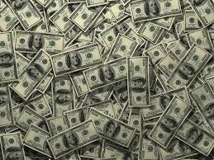
Aspects of Money
Ecclesiastes 5:10
¹⁰ He that loveth silver shall not be satisfied with silver; nor he that loveth abundance with increase: this is also vanity.
Romans 13:8
Don’t borrow – this is an instruction
⁸ Owe no man any thing, but to love one another: for he that loveth another hath fulfilled the law.
Proverbs 22:7
If you are in debt, its hard to do the work of the kingdom
⁷ The rich ruleth over the poor, and the borrower is servant to the lender.
Proverbs 13:22
²² A good man leaveth an inheritance to his children's children: and the wealth of the sinner is laid up for the just.
Proverbs 13:11
Diligent work brings increase
¹¹ Wealth gotten by vanity shall be diminished: but he that gathereth by labour shall increase.
Hebrews 13:5
⁵ Let your conversation be without covetousness; and be content with such things as ye have: for he hath said, I will never leave thee, nor forsake thee.
1 Timothy 6:10
It’s the love of money that’s the problem, not the money itself
¹⁰ For the love of money is the root of all evil: which while some coveted after, they have erred from the faith, and pierced themselves through with many sorrows.

Slide 20
Additional Aspects of Money
Matthew 6:24
Who’s in charge?
²⁴ No man can serve two masters: for either he will hate the one, and love the other; or else he will hold to the one, and despise the other. Ye cannot serve God and mammon.
Psalms 37:16-17
This is not saying you can’t have a lot.
¹⁶ A little that a righteous man hath is better than the riches of many wicked.
¹⁷ For the arms of the wicked shall be broken: but the Lord upholdeth the righteous.

Slide 21
Summary of Money
Put God first
Honor his prophets
Make a life style of giving and men will give into your bosom
Always speak in faith – It is well!
Remember it’s the love of money that is the root of all evil
Prosperity is not a money term
its having more than enough in all areas of life
Spiritual, Physical, Financial, Emotional, and mental
Faith can be a form of prosperity – bags full of money, gold, or shekels wouldn’t have done the disciples any good
when they are about to die in a storm
Solomon was prosperous in first wisdom, knowledge, and then an abundance of wealth
Read proverbs every day and you will deal wisely in all the affairs of life
Ecclesiastes 11:1
11 Cast thy bread upon the waters: for thou shalt find it after many days.

