Slide 1
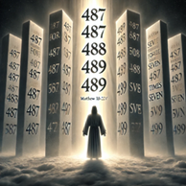
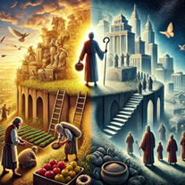
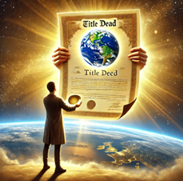
Treat others like you would a kitten – be gentle
Fruits of the Spirit – Part 3
Longsuffering, gentleness,
Meekness and temperance
Long Suffering - Matthew 18:21-22 Then came Peter to him, and said, Lord, how oft shall my brother sin against me, and I forgive him? till seven times?
22 Jesus saith unto him, I say not unto thee, Until seven times: but, Until seventy times seven.
490
Temperance is the practice of self-restraint, moderation, and balance in one's actions, thoughts, and desires.
2 Peter 1:5-8
And beside this, giving all diligence, add to your faith virtue; and to virtue knowledge;
6 And to knowledge temperance; and to temperance patience; and to patience godliness;
7 And to godliness brotherly kindness; and to brotherly kindness charity.
8 For if these things be in you, and abound, they make you that ye shall neither be barren nor unfruitful in the knowledge of our Lord Jesus Christ.
2 Timothy 2:24-26
24 And the servant of the Lord must not strive; but be gentle unto all men, apt to teach, patient,
25 In meekness instructing those that oppose themselves; if God peradventure will give them repentance to the acknowledging of the truth;
26 And that they may recover themselves out of the snare of the devil, who are taken captive by him at his will.
Matthew 5:5
Blessed are the meek: for they shall inherit the earth.
1 Peter 5:6 – To be meek is to be humble
Humble yourselves therefore under the mighty hand of God, that he may exalt you in due time:
Matthew 25:23 "His lord said unto him, Well done, good and faithful servant; thou hast been faithful over a few things, I will make thee ruler over many things: enter thou into the joy of thy lord."

Slide 2
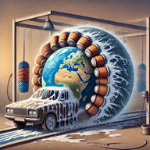
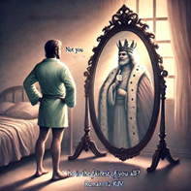
Faith Commercial – God’s transformer services
Does your car show you an image of a transformer in the center video console as you start it?
When you drive through the car wash do you come out looking like you have been conformed to this world?
When you ask the question in the morning, who is the fairest of them all – does you mirror answer, “Not You!”
!! Someone is trying to get your attention !!
For just 1 mustard seed of Faith
No longer do you have to be conformed to this world - You too can be transformed by the renewing of your mind – proving what is that Good, and acceptable and perfect will of God. Benefits include: no longer thinking of yourself more highly than you ought to think, thinking soberly as God has dealt to every man the measure of faith, and free oil of joy change after 90 days.
See what God’s transformer services can do for you!
We now return to your regularly scheduled Bible study

