Slide 1
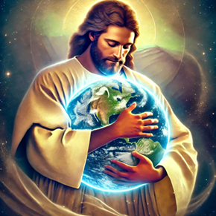
Fruits of the Spirit – Part – 4 Goodness
The ultimate expression of Goodness – Grace in Action
Matthew 19:17 – There is none good but God
17 And he said unto him, Why callest thou me good? there is none good but one, that is, God: but if thou wilt enter into life, keep the commandments.
Acts 10:38 - He went about DOING good
How God anointed Jesus of Nazareth with the Holy Ghost and with power: who went about doing good, and healing all that were oppressed of the devil; for God was with him.
16 For God so loved the world, that he gave his only begotten Son, that whosoever believeth in him should not perish, but have everlasting life.
Psalm 23:6 – Goodness and mercy know each other
Surely goodness and mercy shall follow me all the days of my life: and I will dwell in the house of the Lord for ever.
Romans 12:21 – Overcome evil with Good
Be not overcome of evil, but overcome evil with good.
Ephesians 2:10 – We were created unto Good works
10 For we are his workmanship, created in Christ Jesus unto good works, which God hath before ordained that we should walk in them.
The Opposite of Goodness
James 2:16
And one of you say unto them, Depart in peace, be ye warmed and filled; notwithstanding ye give them not those things which are needful to the body; what doth it profit?

Slide 2
Fruits of the Spirit – Part 4
Discussion Questions
What are the tongues of angles?
What value is equated to those who can remove mountains but have not love?
What are the 3 things which abide and which is the greatest?
What does it mean to walk in love?
How do we walk in love?
Define that which is in part
What are you supposed to rejoice in?
What are you not supposed to rejoice in?
Who doesn’t know God?
What does it mean to bear fruit?
Which fruit of the spirit never fails?
What happens to knowledge?
What doesn’t behave itself un-seemingly?
What should evil be overcome with?
What did Jesus do after he was anointed with the Holy Ghost and power?
What did God before ordain that we should walk there in?
Who is the only one Jesus called good?
What happened to those who were oppressed of the devil?
What is the requirement for ever lasting life?
Name the amount of shekels you will earn for saying depart in peace and be warm without providing what is needed for that to happen?
Who shall inherit the earth?
How often should you forgive someone if you had to put a # on it?
To Faith Add virtue – to virtue add knowledge – to knowledge add what?
How should the servant of the Lord treat all men?

